Slide 1

Smart Transmission
Aaron Grant
Horatio Cowan
Molly Segee
Carl Burnham

Slide 2
Schedule
January: Ordering Parts & beginning fabrication
February: Continuing fabrication & Assembly
March: Assembly and Initial Testing
April: Coding & Calibration
May: Presentation

Slide 3
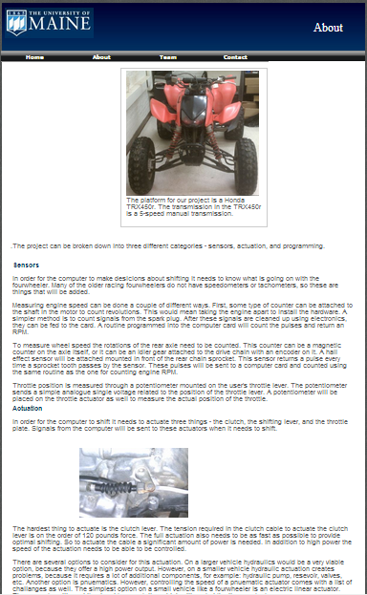


New Website

Slide 4
Total Costs
qty | part |  |  |  |  |  |  | cost per | total cost
1 | 2004 Honda TRX 450R |  |  |  |  |  |  | $2,000.00 | $2,000.00
1 | 3-Wire Extension Cables (Large Bundle) P/N: 276-1424 |  |  |  |  |  |  | $39.99 | $39.99
2 | IFI VEX Pro Victor 888, Part number: 217-2769 |  |  |  |  |  |  | $49.99 | $99.98
1 | 6-POSITION ATO/ATC FUSE PANEL WITH COVER AND COMMON GROUND: Product number: WIRTH-31060 |  |  |  |  |  |  | $19.10 | $19.10
3 | Fuse ATC Standard Blade Auto 3 Amp Violet: Product number: FU-509123 |  |  |  |  |  |  | $0.15 | $0.45
3 | Fuse ATC Standard Blade Auto 15 Amp Blue: product number: FU-509128 |  |  |  |  |  |  | $0.15 | $0.45
3 | Fuse ATC Standard Blade Auto 25 Amp Clear: Product number: FU-509130 |  |  |  |  |  |  | $0.15 | $0.45
7 | Wire 8 Gauge Red Sold by the foot Product Code #: WI-230702 |  |  |  |  |  |  | $0.90 | $6.30
7 | Wire 8 Gauge Black Sold by the foot Product Code #: WI-230700 |  |  |  |  |  |  | $0.89 | $6.23
10 | Lug Straight Heavy Duty 8 GA #10 Hole Product Code #: LU-1800HD |  |  |  |  |  |  | $0.54 | $5.40
10 | Lug Straight Heavy Duty 8 GA 1/4" Hole Product Code #: LU-1801HD |  |  |  |  |  |  | $0.54 | $5.40
20 | Connector Nylon Tab Insulated Female, .250" Blade 16-14 GA, Blue Product Code #: CT-163258 |  |  |  |  |  |  | $0.25 | $5.00
15 | Connector Nylon Tab Insulated Male, .250" Blade 16-14 GA, Blue Product Code #: CT-163260 |  |  |  |  |  |  | $0.19 | $2.85
10 | Connector Premium Nylon #6 Ring Terminal Double Crimp 16-14 AWG Blue Product Code #: CT-163202 |  |  |  |  |  |  | $0.23 | $2.30
1 | Dual USB Power Hub 2 Amp product code: 22-1-39290-8 |  |  |  |  |  |  | $16.99 | $16.99
1 | All Weather 12 Volt Power Socket, product code: 22-1-39052-8 |  |  |  |  |  |  | $13.99 | $13.99
1 | Slide Potentiometers 60mm TRVL Linear 10K Part #: 312-9301F-10K |  |  |  |  |  |  | $2.55 | $2.55
1 | Tubular High-Speed Linear Actuator (Stroke Size 3", Force 11 lbs, Speed 9.05"/sec), Part number: PA-15-3-11 |  |  |  |  |  |  | $157.00 | $157.00
1 | Electrak Pro PR12-02-2A65-02-LSB Linear Actuator |  |  |  |  |  |  | $518.21 | $518.21
1 | Adafruit Assembled Data Logging shield for Ardino, ID: 1141 |  |  |  |  |  |  | $19.95 | $19.95
1 | Arduino Mega 2560 R3 (Atmega2560 - assembled) ID 191 |  |  |  |  |  |  | $65.00 | $65.00
2 | Panel Mount 10K potentiometer (Breadboard Friendly) ID 562 |  |  |  |  |  |  | $0.95 | $1.90
2 | Arduino Uno R3 (Atmega328 -assembled) |  |  |  |  |  |  | $29.95 | $59.90
1 | Sensor Gear Tooth Hall Effect, Part number: 480-2021-ND |  |  |  |  |  |  | $40.30 | $40.30
1 | 12V, 1.6A, 233 oz-in Geared Bipolar Stepper Motor, product code: RB-Phi-131 |  |  |  |  |  |  | $35.00 | $35.00
1 | 50 AMP MANUAL-RESET DC CIRCUIT BREAKER BPC Item# 11-3317-50 |  |  |  |  |  |  | $21.95 | $21.95
1 | Arduino Motor Shield R3 |  |  |  |  |  |  | $25.95 | $25.95
2 | BYTECC USB2-3AB-K 3 ft. Type A Male to Type B Male Cable |  |  |  |  |  |  | $2.99 | $5.98
 |  |  |  |  |  |  |  |  | $3,178.57
A complete list of parts and cost estimates has made its way through the design spiral
Total cost is estimated at $3178.57

Slide 5
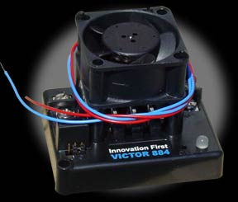
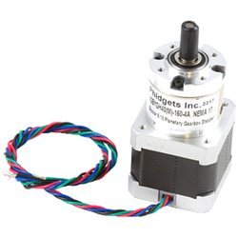
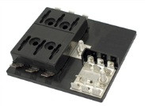
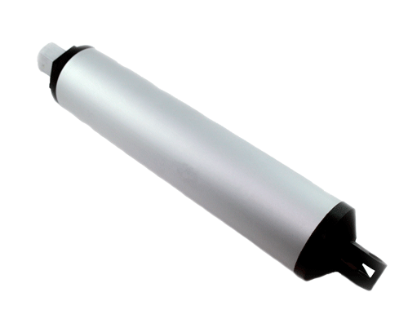
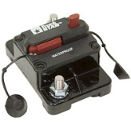
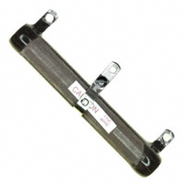
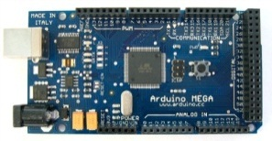
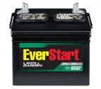
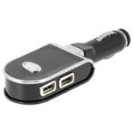
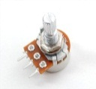

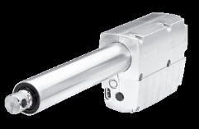

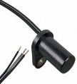


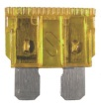
Parts List
qty | part | Status
1 | 2004 Honda TRX 450R | Arrived
1 | 3-Wire Extension Cables (Large Bundle) P/N: 276-1424 | Ordered
2 | IFI VEX Pro Victor 888, Part number: 217-2769 | Ordered
1 | 6-POSITION ATO/ATC FUSE PANEL WITH COVER AND COMMON GROUND: Product number: WIRTH-31060 | Ordered
3 | Fuse ATC Standard Blade Auto 3 Amp Violet: Product number: FU-509123 | Ordered
3 | Fuse ATC Standard Blade Auto 15 Amp Blue: product number: FU-509128 | Ordered
3 | Fuse ATC Standard Blade Auto 25 Amp Clear: Product number: FU-509130 | Ordered
7 | Wire 8 Gauge Red Sold by the foot Product Code #: WI-230702 | Ordered
7 | Wire 8 Gauge Black Sold by the foot Product Code #: WI-230700 | Ordered
10 | Lug Straight Heavy Duty 8 GA #10 Hole Product Code #: LU-1800HD | Ordered
10 | Lug Straight Heavy Duty 8 GA 1/4" Hole Product Code #: LU-1801HD | Ordered
20 | Connector Nylon Tab Insulated Female, .250" Blade 16-14 GA, Blue Product Code #: CT-163258 | Ordered
15 | Connector Nylon Tab Insulated Male, .250" Blade 16-14 GA, Blue Product Code #: CT-163260 | Ordered
10 | Connector Premium Nylon #6 Ring Terminal Double Crimp 16-14 AWG Blue Product Code #: CT-163202 | Ordered
1 | Dual USB Power Hub 2 Amp product code: 22-1-39290-8 | Ordered
1 | All Weather 12 Volt Power Socket, product code: 22-1-39052-8 | Ordered
1 | Slide Potentiometers 60mm TRVL Linear 10K Part #: 312-9301F-10K | Ordered
1 | Tubular High-Speed Linear Actuator (Stroke Size 3", Force 11 lbs, Speed 9.05"/sec), Part number: PA-15-3-11 | Ordered
1 | Electrak Pro PR12-02-2A65-02-LSB Linear Actuator | Ordered
1 | Adafruit Assembled Data Logging shield for Ardino, ID: 1141 | Ordered
1 | Arduino Mega 2560 R3 (Atmega2560 - assembled) ID 191 | Arrived
2 | Panel Mount 10K potentiometer (Breadboard Friendly) ID 562 | Arrived
2 | Arduino Uno R3 (Atmega328 -assembled) | Arrived
1 | Sensor Gear Tooth Hall Effect, Part number: 480-2021-ND | Arrived
1 | 12V, 1.6A, 233 oz-in Geared Bipolar Stepper Motor, product code: RB-Phi-131 | Arrived
1 | 50 AMP MANUAL-RESET DC CIRCUIT BREAKER BPC Item# 11-3317-50 | Ordered
1 | Arduino Motor Shield R3 | Ordered
2 | BYTECC USB2-3AB-K 3 ft. Type A Male to Type B Male Cable | Ordered

Slide 6
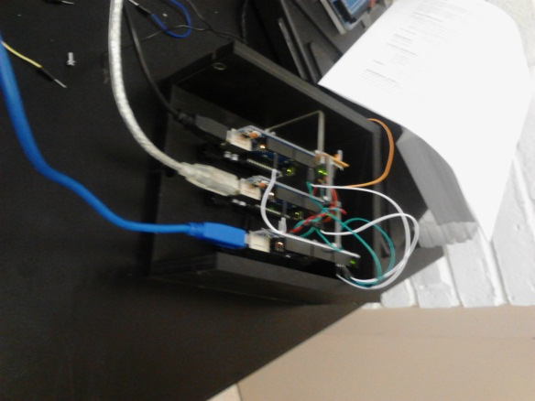
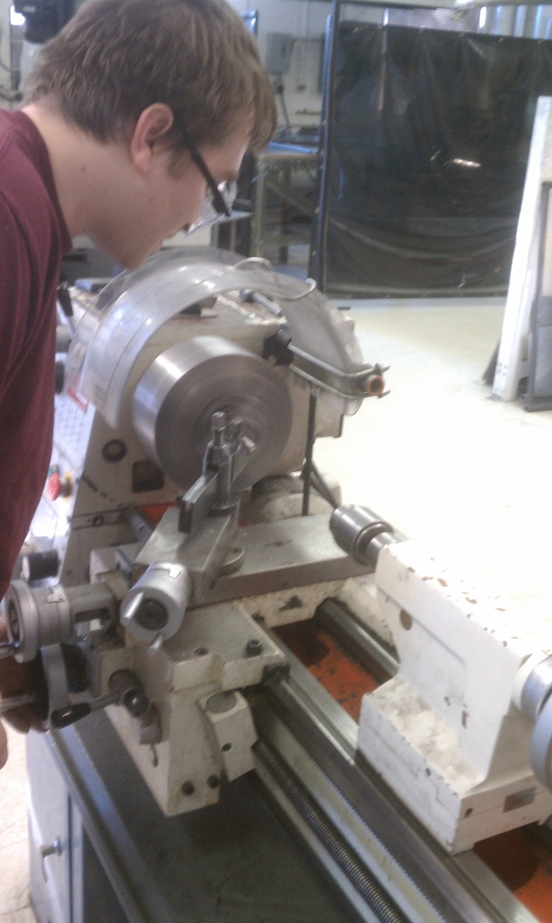
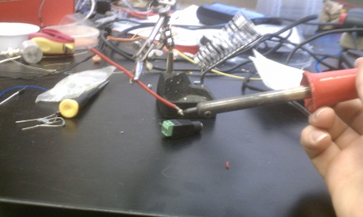
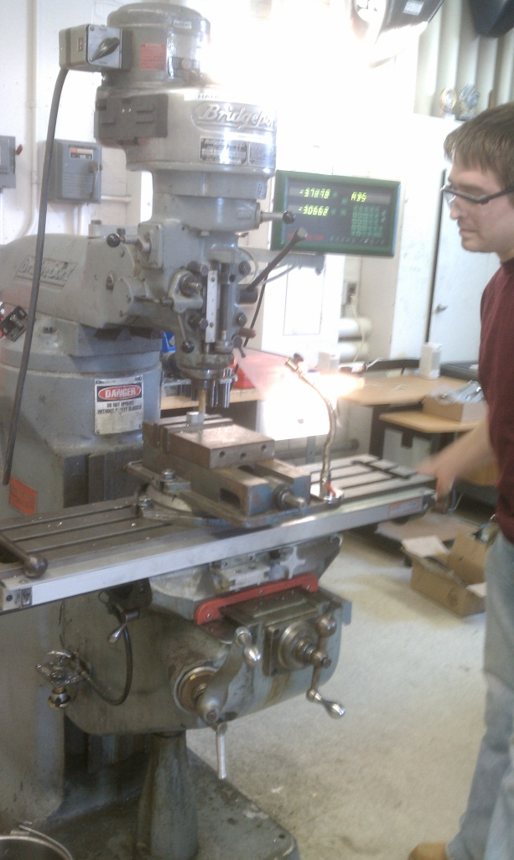
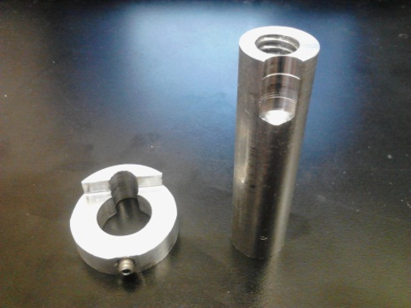
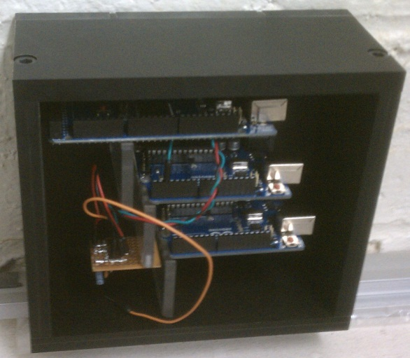
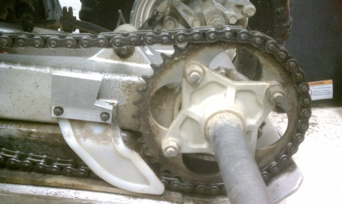
Beginning fabrication and assembly

Slide 7
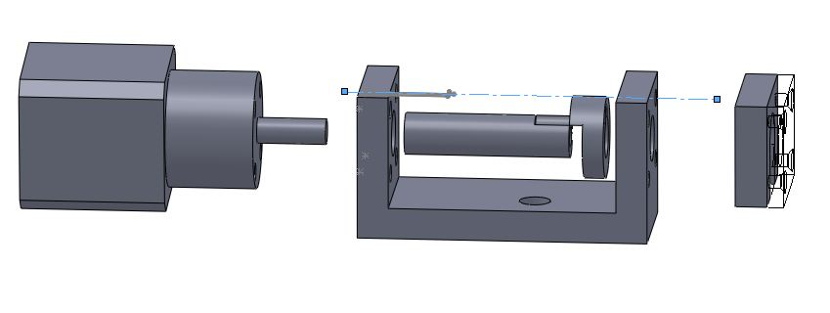
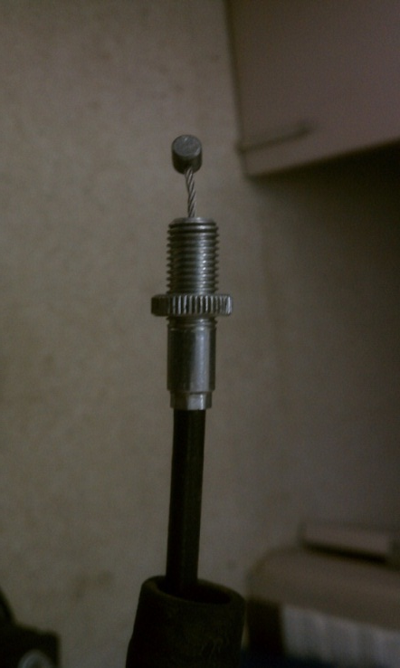
Throttle cable actuation assembly
Needs:
A bobbin to reel in the cable
A mount to hold the potentiometer
A bracket to tie all the pieces together

Slide 8
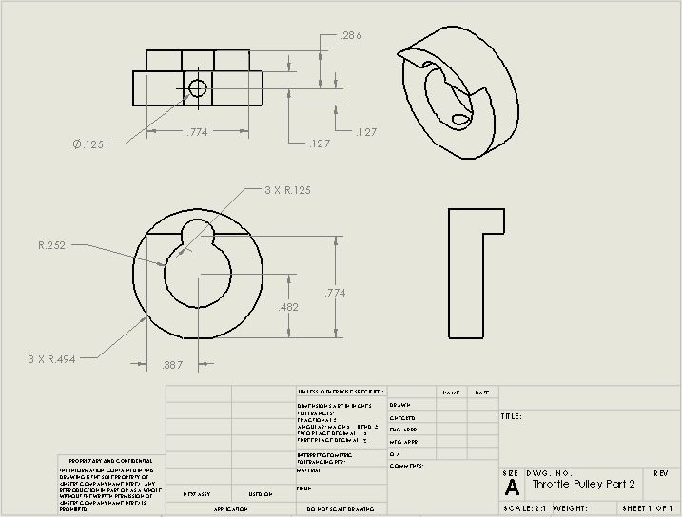
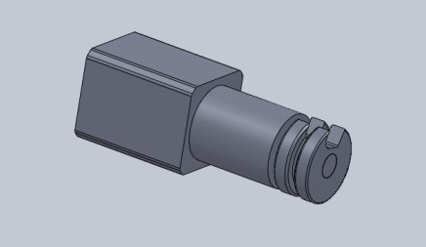
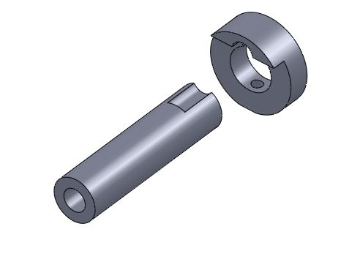
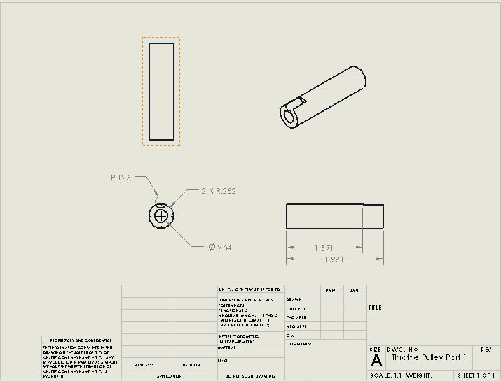
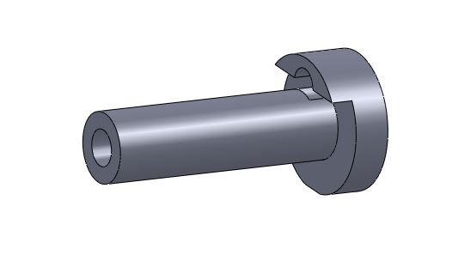
Throttle Cable “Bobbin”
Original design
Refined design

Slide 9
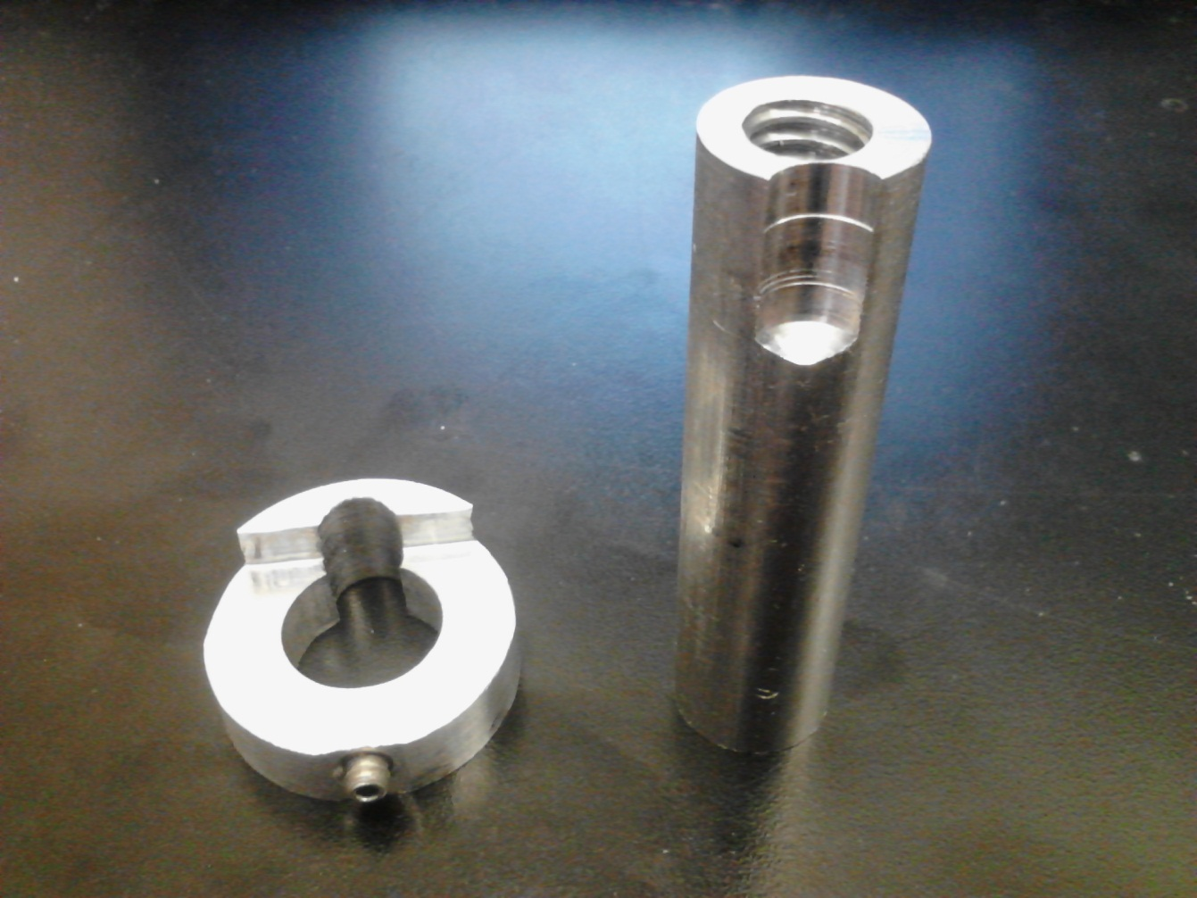
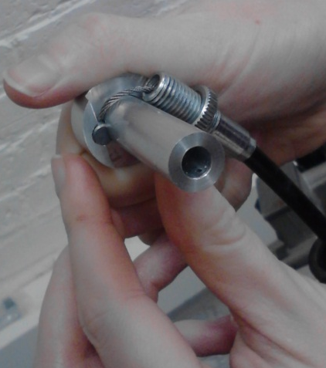
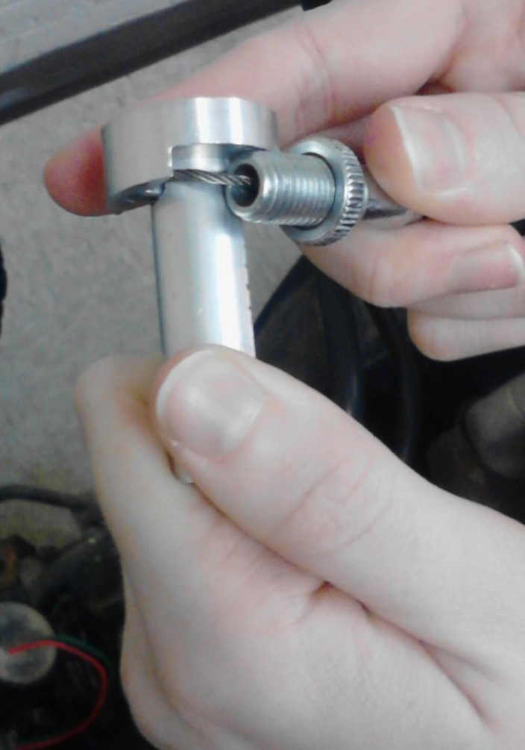
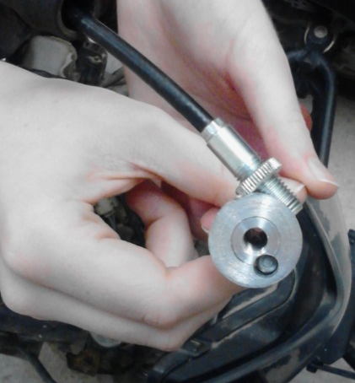
Throttle Cable “Bobbin”

Slide 10
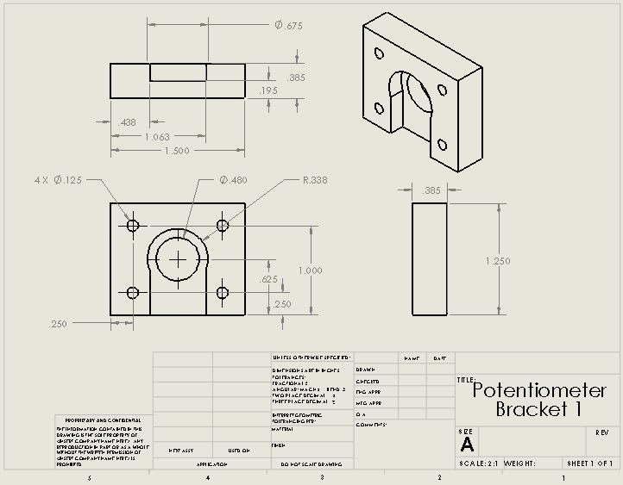
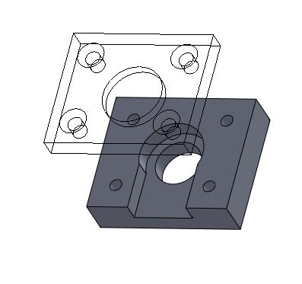
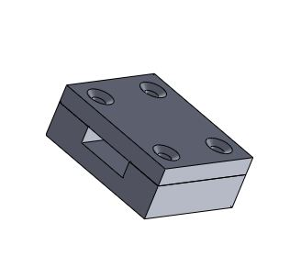
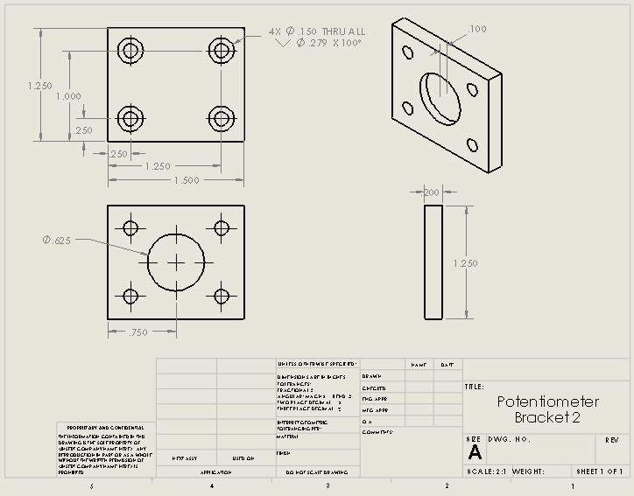
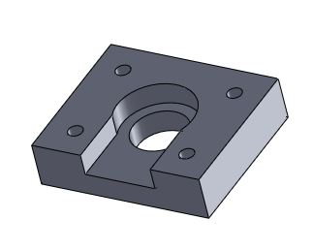
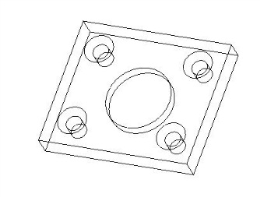
Potentiometer mount

Slide 11
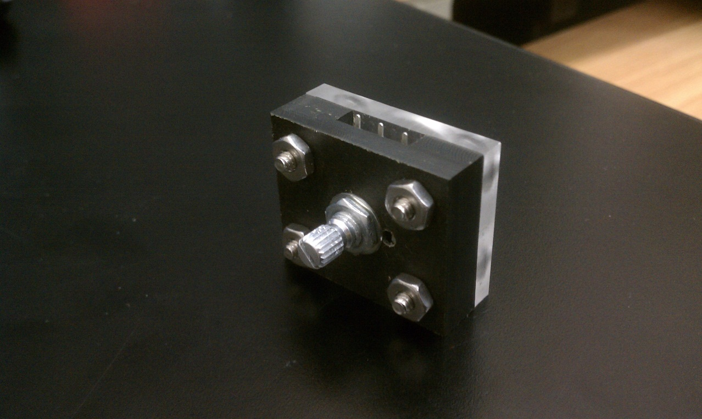
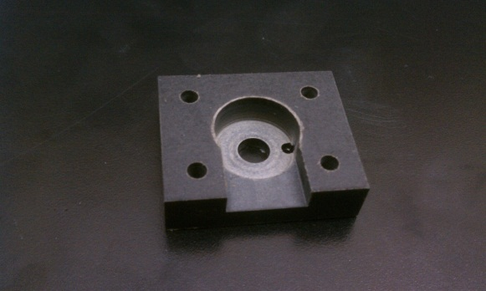
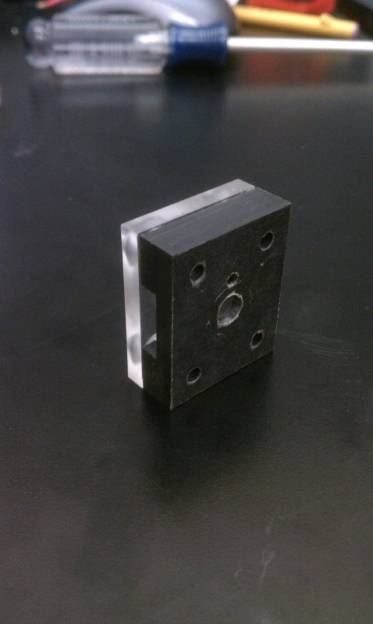
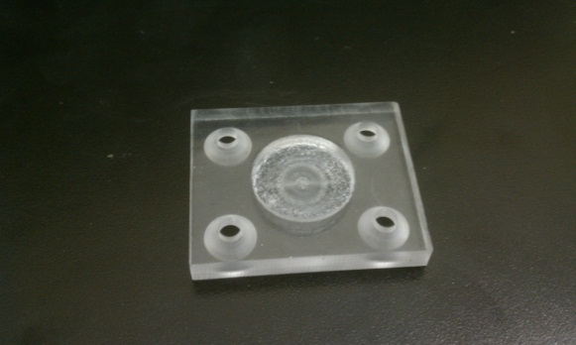
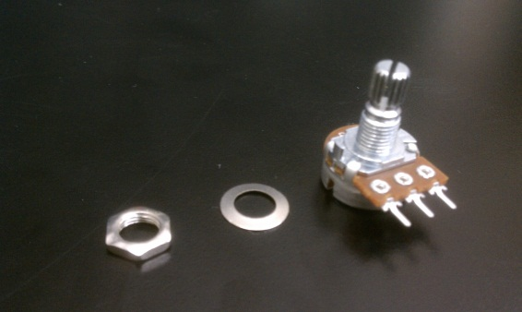
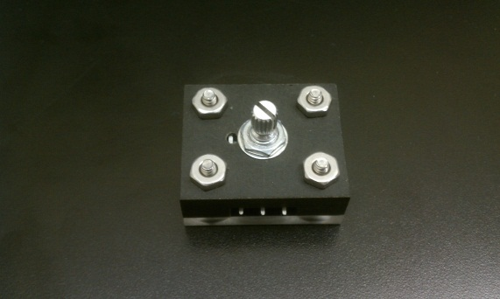
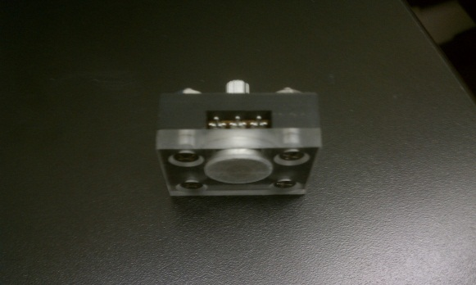
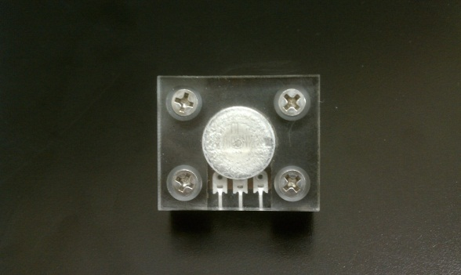
Potentiometer mount

Slide 12
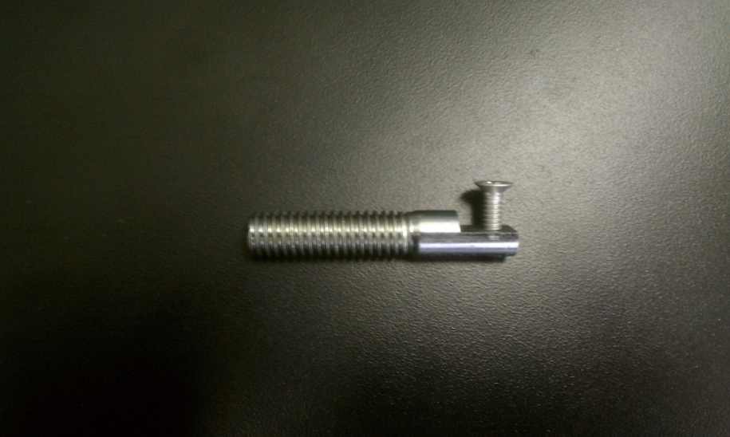
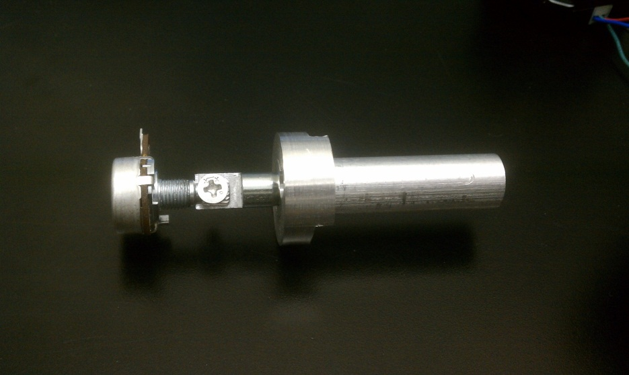
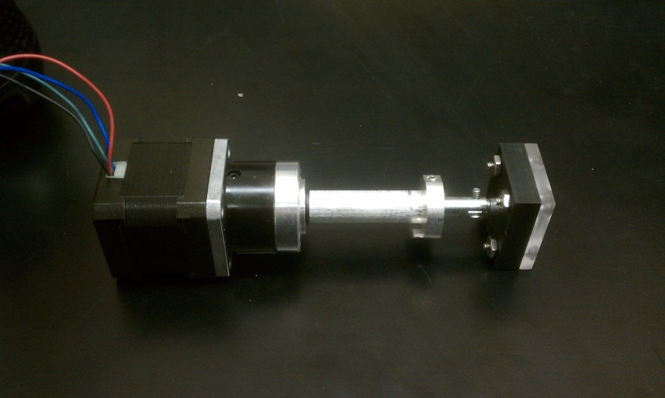
Connecting the bobbin to the potentiometer

Slide 13
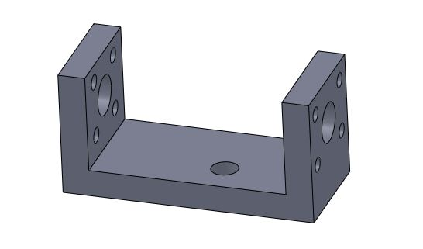

Attachment bracket

Slide 14



Wheel Speed Sensor Bracket Design

Slide 15


Wheel Speed Sensor Bracket
Hall effect Sensor has been Ordered
Hall effect Sensor Mount has been fabricated
Pulse Counting Routine has been written and tested

Slide 16








Control Box Design

Slide 17

Control Box
1 Arduino Mega for primary control
2 Arduino Uno cards, 1 for pulse counting from the wheel speed, and one for pulse counting for the engine speed
555-timer creates clean sqaure waves for pulse counting

Slide 18

New and Improved Pulse Counting routine
Reduced error
Simpler code

Slide 19
Overcurrent Protection
Protect against short circuits or overload
Master breaker directly off of the battery
Smaller individual fuses for each component
Rule of thumb: Size fuses at 135% of full load steady state current rounded to nearest available fuse size.

Slide 20
Breaker sizing
Fuse sizing
Stepper motor is rated at 1.7 amps: use 3 amp fuse
Shifter Linear actuator rated at 8 amps: use 15 amp fuse
Clutch Actuator rated at 18 amps: use 25 amp fuse.
Combined maximum current draw of all components estimated at 35 amps. Use 50 amp breaker.

Slide 21






Wiring
mega
uno
Stepper motor
Motor shield
Usb charger
High speed linear actuator
888 victor
12 volt socket
Elektrak Pro linear actuator
888 victor
Master
breaker
Fuse block
battery

Slide 22

Original Arduino Wiring Plan

Slide 23

Alternate Arduino Wiring Plan

Slide 24


555 timer wiring

Slide 25
Moving Forward
Design and build panel for mounting fuse box, Control Box, and motor controllers.
Finish fabrication on throttle cable actuator mount.
Mount and wire wheel speed hall effect sensor.
Wire engine speed sensor to 555 timer.
Test pulse counting on 4-wheeler platform.
Design and build a control panel on handlebars.

Slide 26


Questions?

