Slide 1

Smart Transmission
Aaron Grant
Horatio Cowan
Molly Segee
Carl Burnham

Slide 2
Schedule
January: Ordering Parts & beginning fabrication
February: Continuing fabrication & Assembly
March: Assembly and Initial Testing
April: Coding & Calibration
May: Presentation

Slide 3
Parts
qty | part | Status
1 | 2004 Honda TRX 450R | Arrived
1 | 3-Wire Extension Cables (Large Bundle) P/N: 276-1424 | Arrived
2 | IFI VEX Pro Victor 888, Part number: 217-2769 | Arrived
1 | 6-POSITION ATO/ATC FUSE PANEL WITH COVER AND COMMON GROUND: Product number: WIRTH-31060 | Arrived
3 | Fuse ATC Standard Blade Auto 3 Amp Violet: Product number: FU-509123 | Arrived
3 | Fuse ATC Standard Blade Auto 15 Amp Blue: product number: FU-509128 | Arrived
3 | Fuse ATC Standard Blade Auto 25 Amp Clear: Product number: FU-509130 | Arrived
7 | Wire 8 Gauge Red Sold by the foot Product Code #: WI-230702 | Arrived
7 | Wire 8 Gauge Black Sold by the foot Product Code #: WI-230700 | Arrived
10 | Lug Straight Heavy Duty 8 GA #10 Hole Product Code #: LU-1800HD | Arrived
10 | Lug Straight Heavy Duty 8 GA 1/4" Hole Product Code #: LU-1801HD | Arrived
20 | Connector Nylon Tab Insulated Female, .250" Blade 16-14 GA, Blue Product Code #: CT-163258 | Arrived
15 | Connector Nylon Tab Insulated Male, .250" Blade 16-14 GA, Blue Product Code #: CT-163260 | Arrived
10 | Connector Premium Nylon #6 Ring Terminal Double Crimp 16-14 AWG Blue Product Code #: CT-163202 | Arrived
1 | Dual USB Power Hub 2 Amp product code: 22-1-39290-8 | Arrived
1 | All Weather 12 Volt Power Socket, product code: 22-1-39052-8 | Arrived
1 | Slide Potentiometers 60mm TRVL Linear 10K Part #: 312-9301F-10K | Arrived
1 | Tubular High-Speed Linear Actuator (Stroke Size 3", Force 11 lbs, Speed 9.05"/sec), Part number: PA-15-3-11 | Arrived
1 | Electrak Pro PR12-02-2A65-02-LSB Linear Actuator | Returning
1 | Adafruit Assembled Data Logging shield for Ardino, ID: 1141 | Arrived
1 | Arduino Mega 2560 R3 (Atmega2560 - assembled) ID 191 | Arrived
2 | Panel Mount 10K potentiometer (Breadboard Friendly) ID 562 | Arrived
2 | Arduino Uno R3 (Atmega328 -assembled) | Arrived
1 | Sensor Gear Tooth Hall Effect, Part number: 480-2021-ND | Arrived
1 | 12V, 1.6A, 233 oz-in Geared Bipolar Stepper Motor, product code: RB-Phi-131 | Arrived
1 | 50 AMP MANUAL-RESET DC CIRCUIT BREAKER BPC Item# 11-3317-50 | Arrived
1 | Arduino Motor Shield R3 | Arrived
2 | BYTECC USB2-3AB-K 3 ft. Type A Male to Type B Male Cable | Arrived
qty | Part |  |  |  |  |  |  | per | total | status
3 | Slide Potentiometers 60mm TRVL Linear 10K Part #: 312-9301F-10K |  |  |  |  |  |  | $2.55 | 7.65 | Ordered
4 | Thick Film Resistors - Through Hole 20watt 5.6ohms 1% Part #: 652-PWR220T-20-5R60F |  |  |  |  |  |  | $3.58 | 14.32 | Ordered
1 | 50 ft Standard Duty Servo Wire (Futaba) Part #: SW24J |  |  |  |  |  |  | $12.95 | 12.95 | Ordered
6 | OEM hitec male (Silver Pin) servo plug and pins |  |  |  |  |  |  | $2.99 | 17.94 | Ordered
1 | 2" Linear Actuator with Preset Limit Switch model #: 6102C |  |  |  |  |  |  | $151.0 | 151 | Ordered
1 | 12" × 24" 3/16" Clear Plastic Sheet Part #: 8560K219 |  |  |  |  |  |  | $20.14 | 20.14 | Ordered
 |  |  |  |  |  |  |  |  | 224 | total

Slide 4
Mech Lab Experiment
We are acquiring engine, wheel speed, and throttle position data from sensors we have mounted on the 4-wheeler.
We will use this data to generate expressions to identify shift points and generate a curve fit which we can use for writing the program.

Slide 5
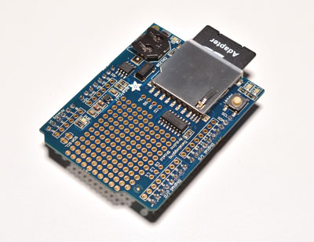
Data Logging Shield
Takes a standard SD card
Has its own real time clock and battery
Creates a new file each time it powers on.
Using the IDE we can write whatever sensor data we want, as many times per second as we want.
Files can then be opened in excel and analyzed.

Slide 6
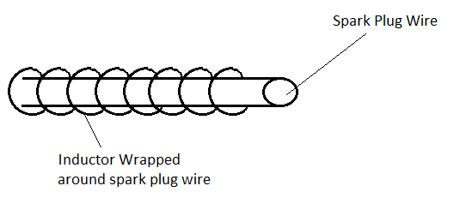
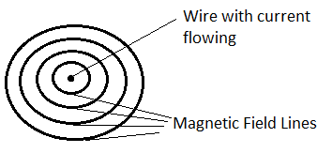
Engine Speed Sensor
The magnetic field lines move in the same direction as the wire. We aren’t getting enough electromagnetic magnetic flux.

Slide 7
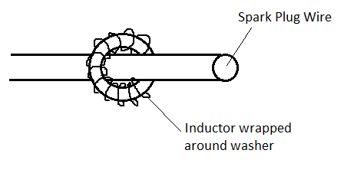
New engine speed inductor
Magnetic field lines are now transverse to the wire.

Slide 8
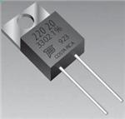
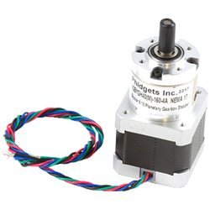
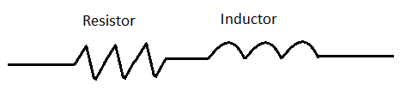
Stepper Motor Control
Rated Current 1.7 amps
Coil Resistance 1.7 ohms
12V/1.7ohms= ~7 amps (Way higher than rated Current)
Stepper motor should not have more than 3 volts applied across it continuously.
Ideally a 5.35 Ω resistor should be used. (they don’t exist) Instead we found a 5.6 Ω.
Stepper Motors use Inductors. This is an LC circuit.
Inductors Charge up, eventually reaching a steady state current.
Once the system has reached steady state, there will be 1.64 amps through the resistor which is a voltage drop of 9.2 volts
The inductor now has the remaining 2.8 volts across it, and the current has not exceeded the rated amount.
At time T=0, there is no current, and thus no voltage drop across the resistor.
Because there is no voltage drop across the resistor, all of the voltage drop occurs across the inductor. This causes the inductor to charge up faster.
Conclusion: Using resistors will make it step faster without losing strength or risking damaging the stepper motor.

Slide 9
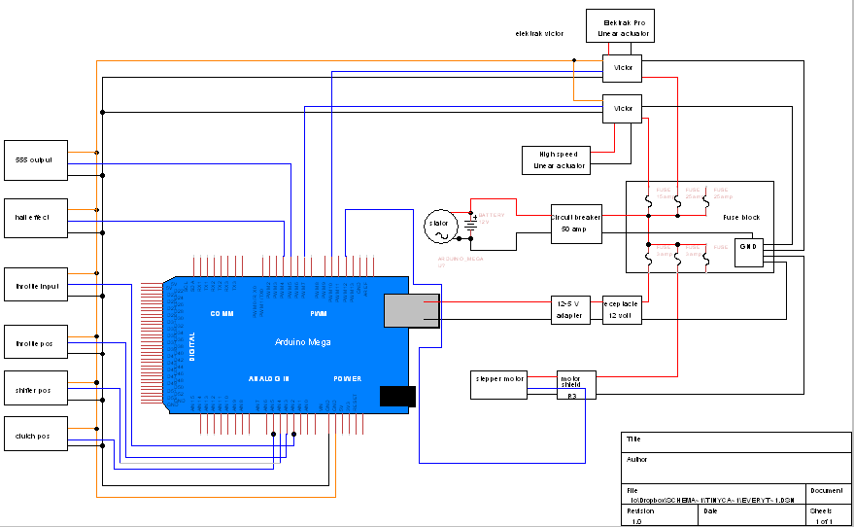
Wiring on the 4-Wheeler

Slide 10
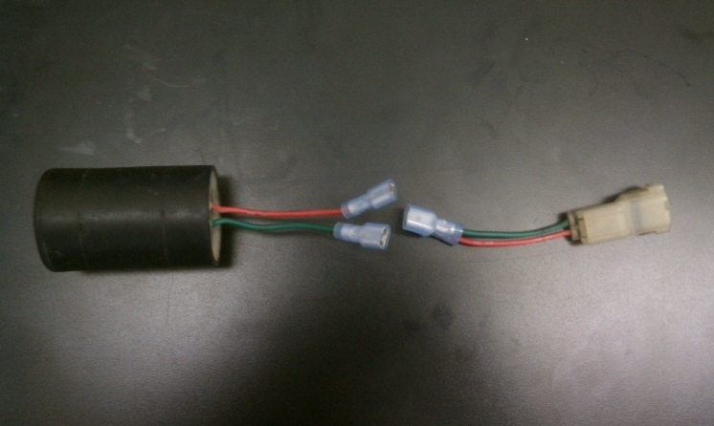
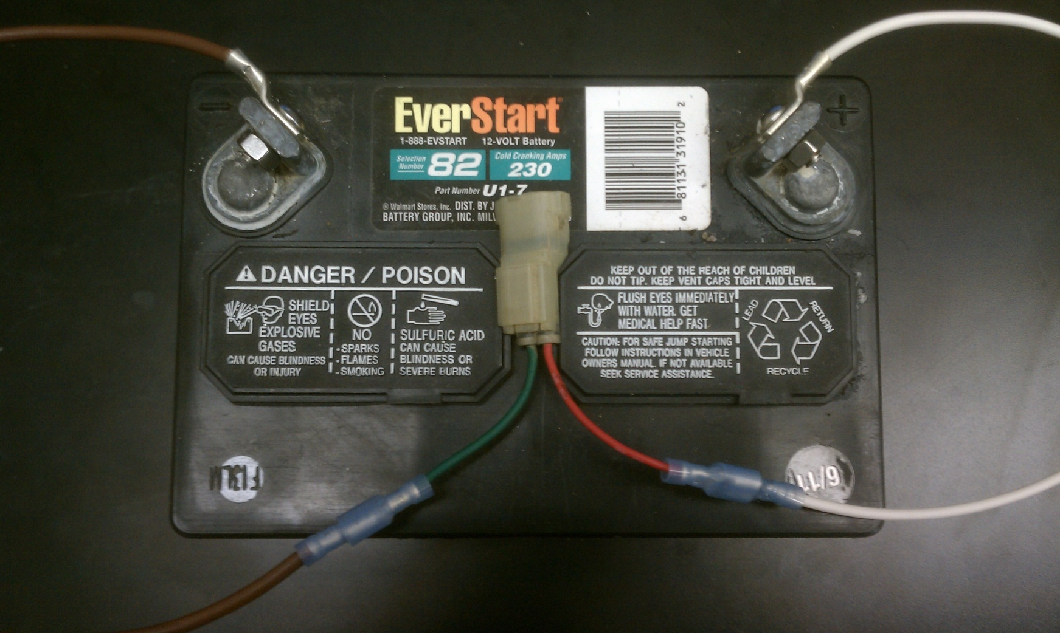
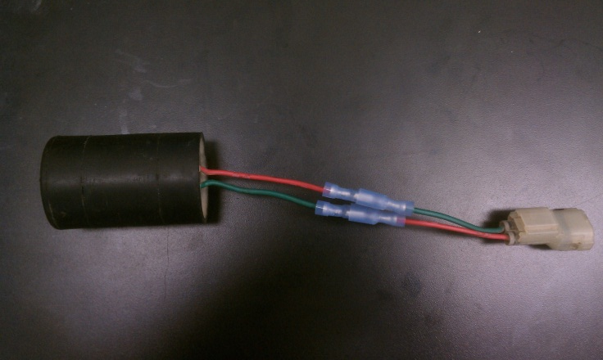
Attaching the stator to the battery

Slide 11
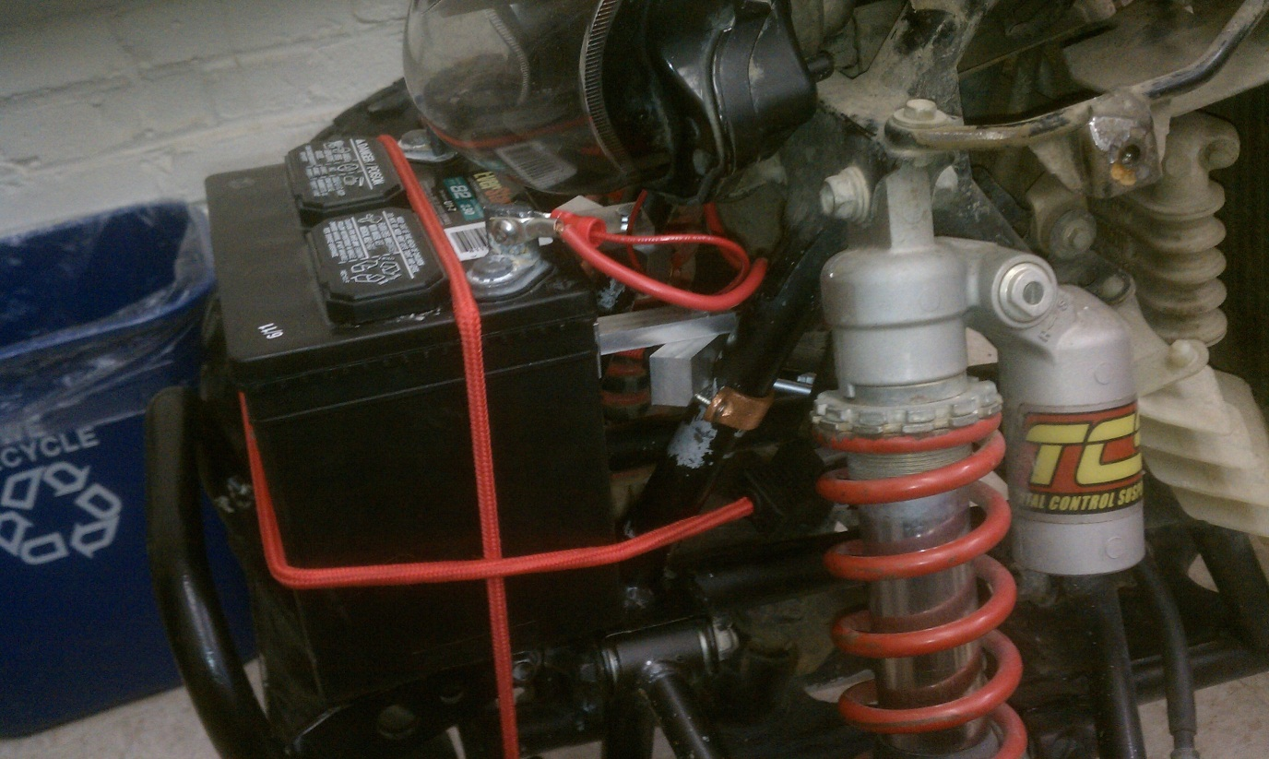
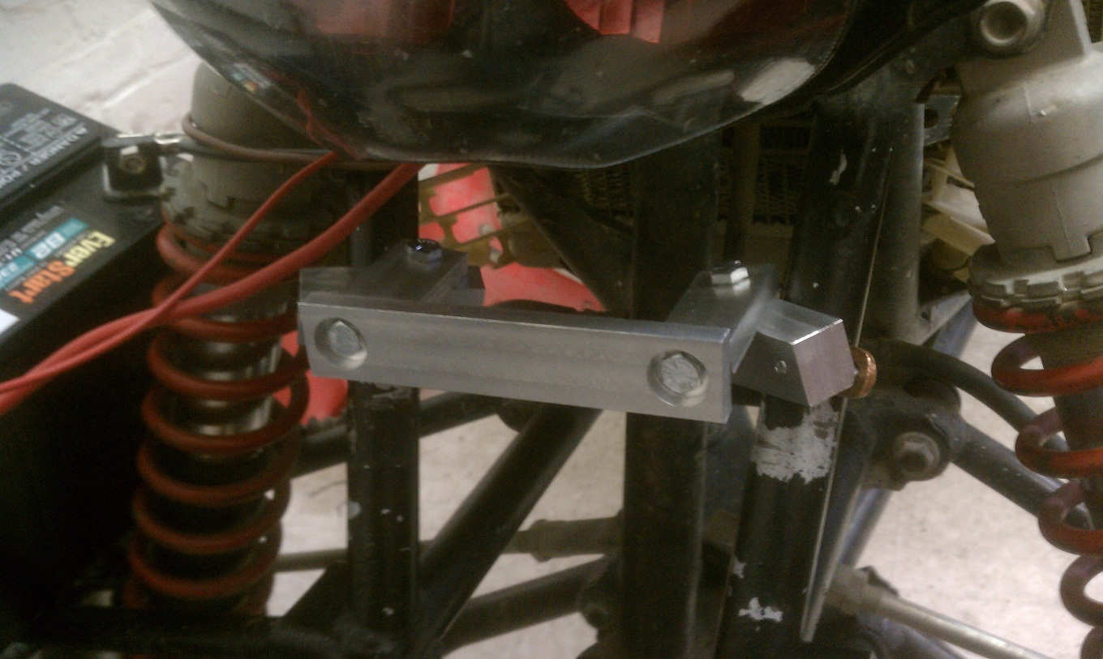
Battery Mount

Slide 12
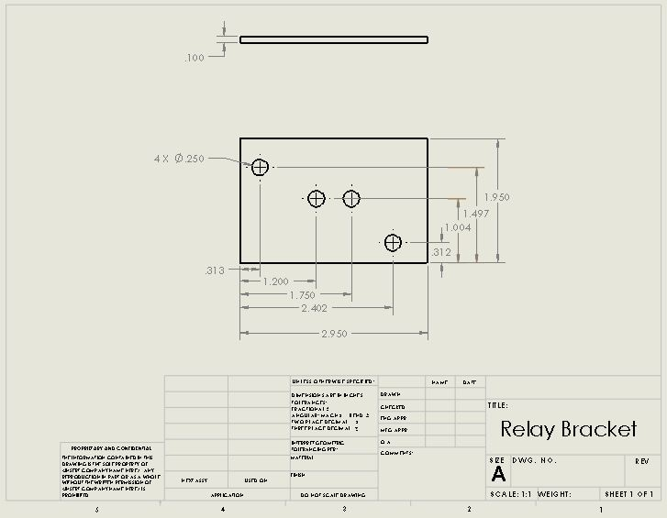
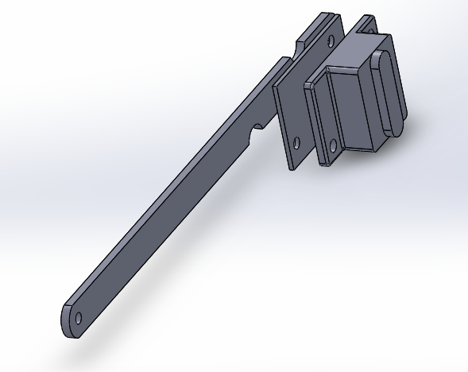
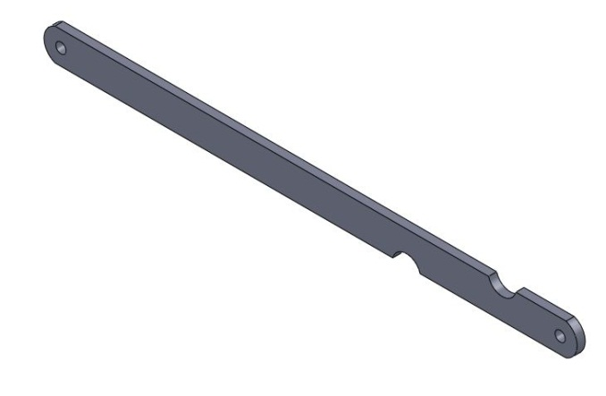
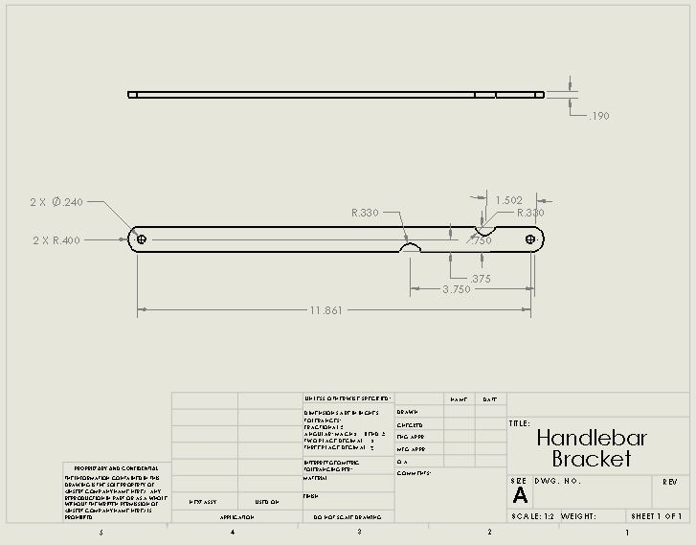
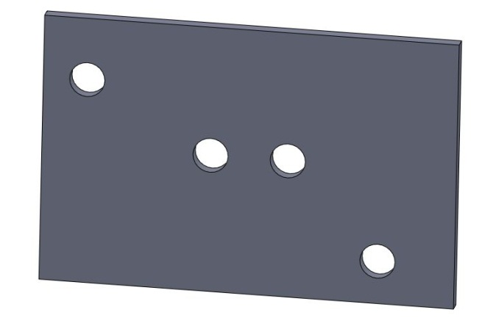
Circuit Breaker Attachment

Slide 13
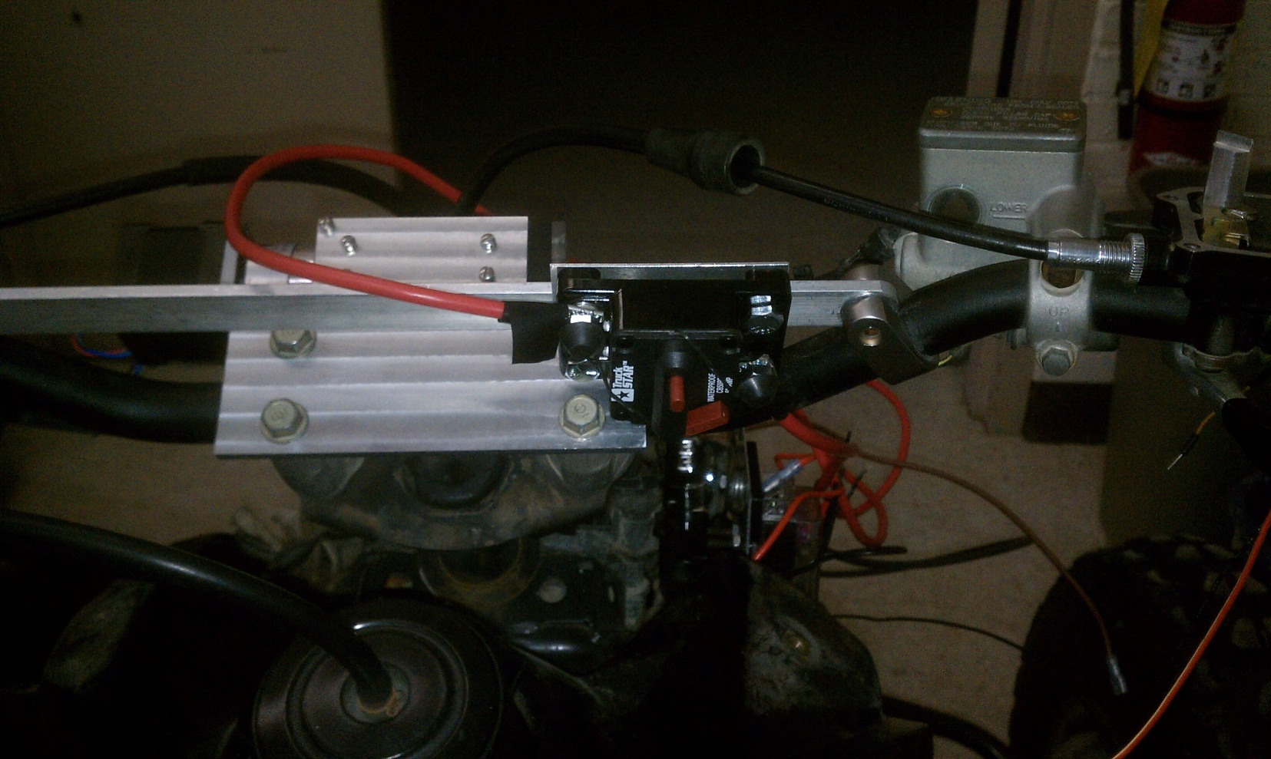
Circuit Breaker Attachment

Slide 14
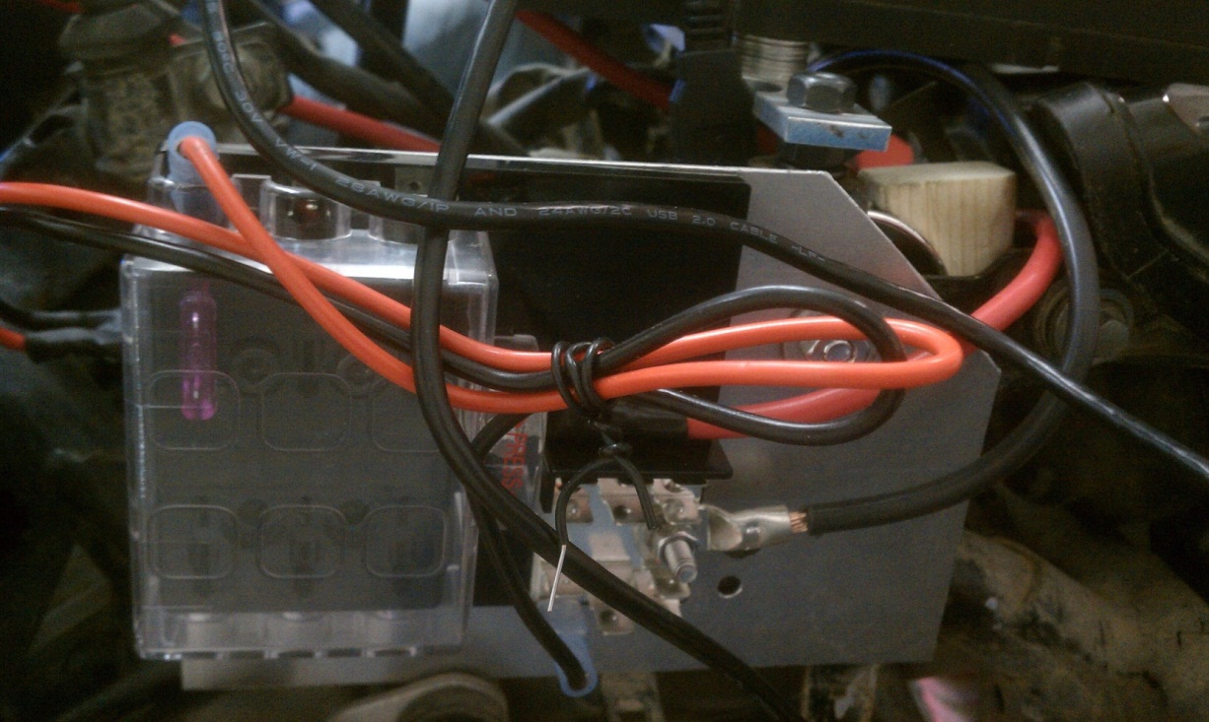
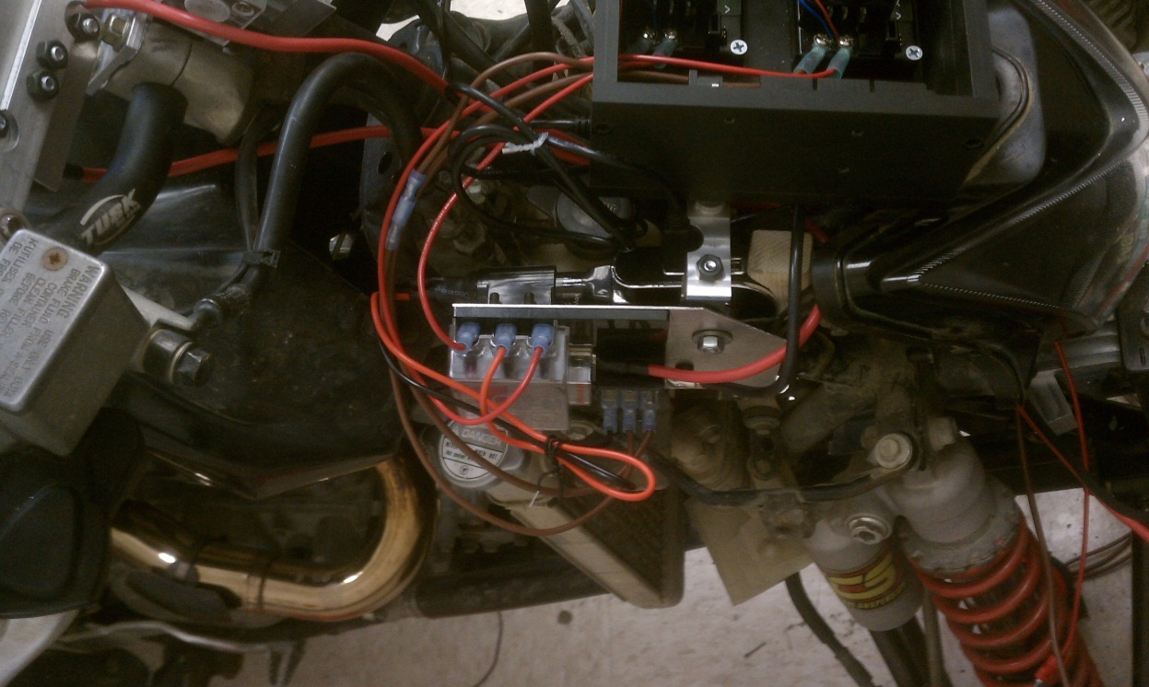
Fuse Box Attachment

Slide 15
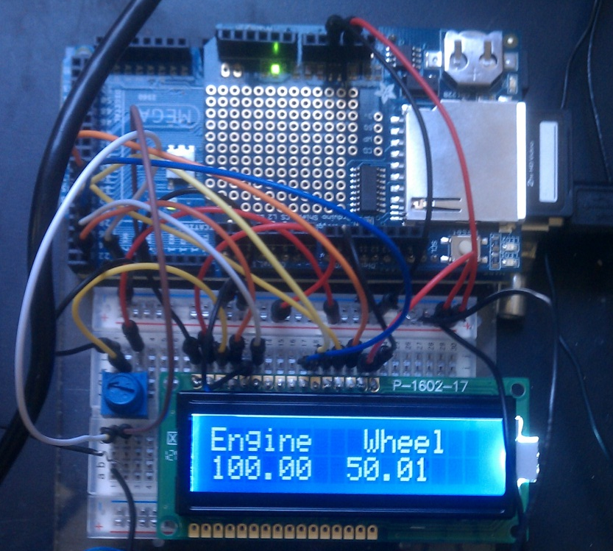
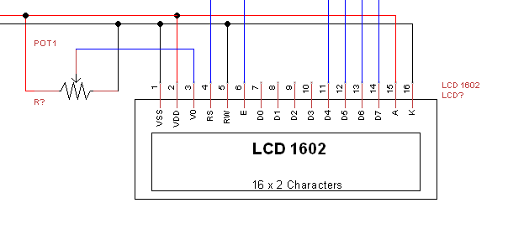
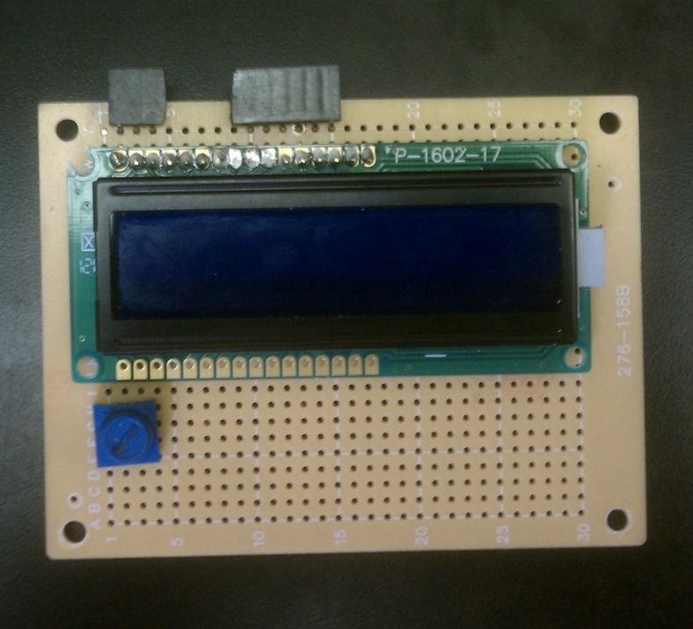
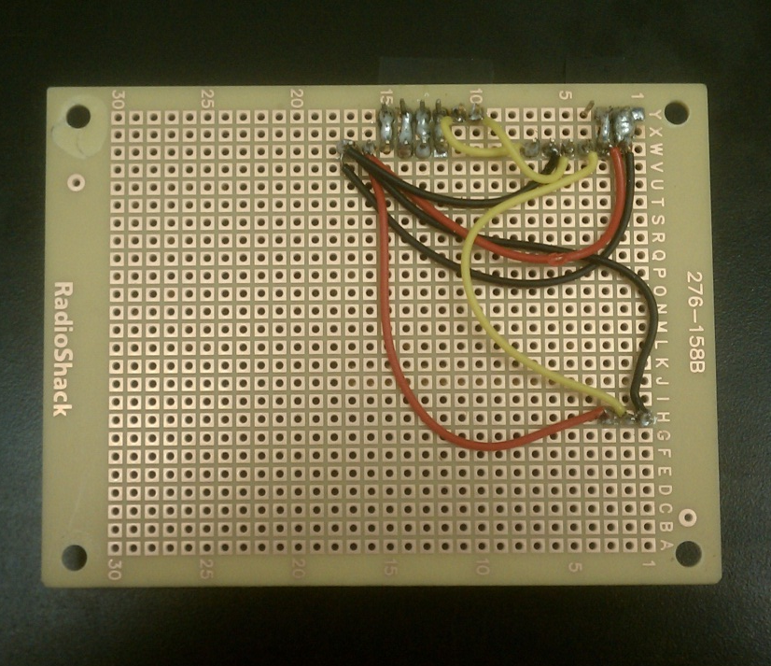
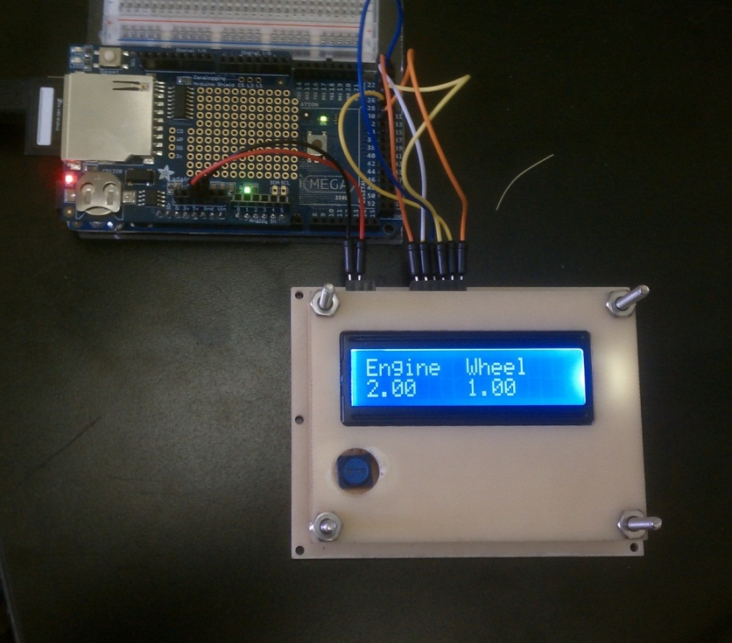
LCD screen

Slide 16
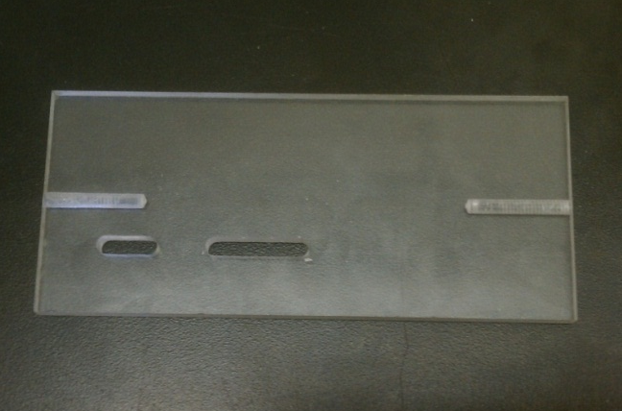
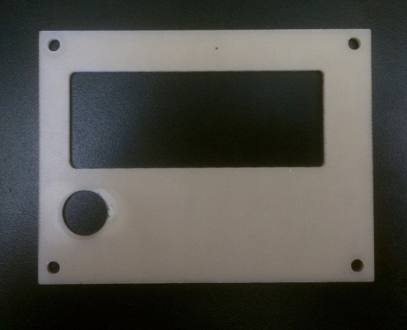
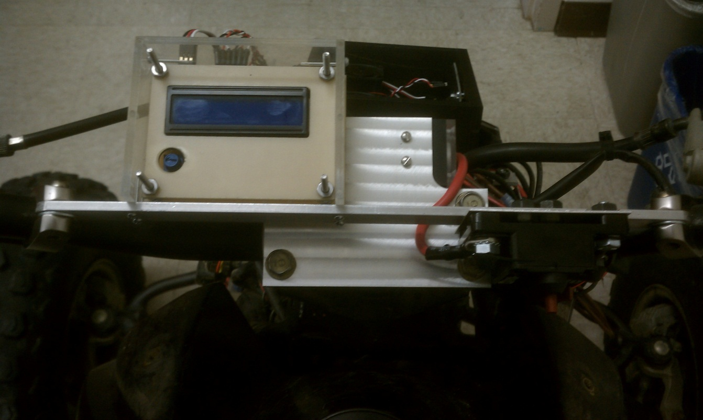
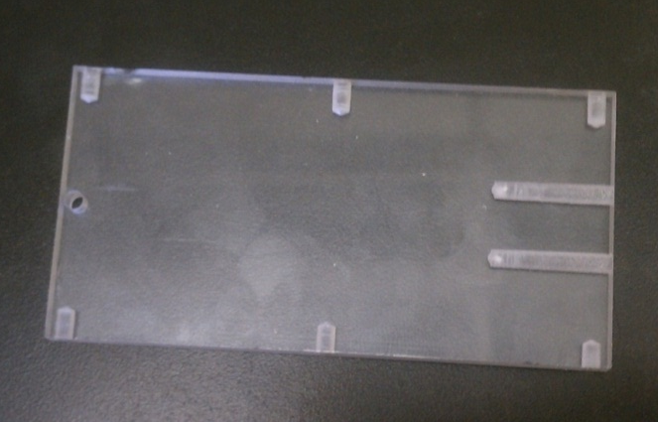
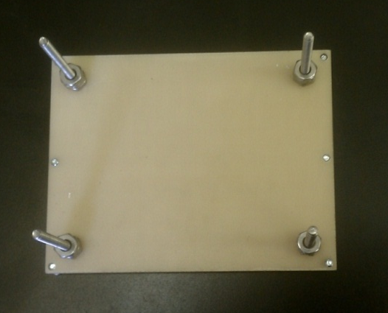
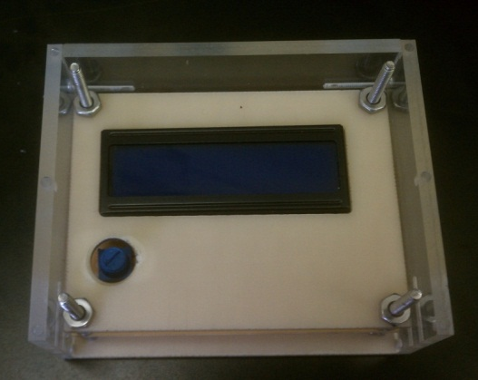
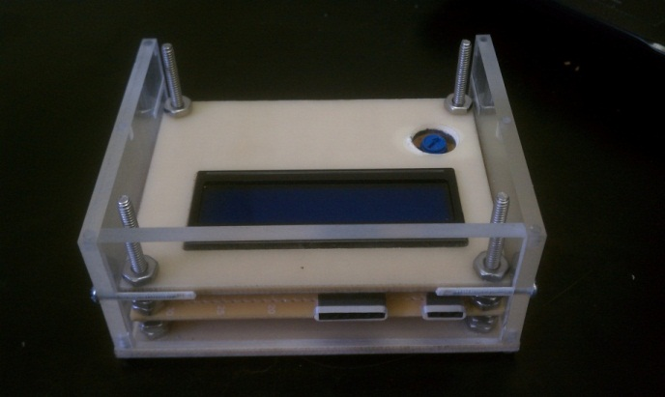
LCD mount

Slide 17
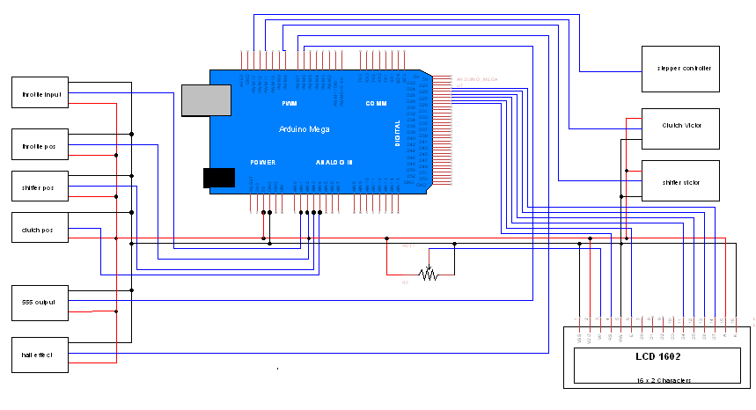
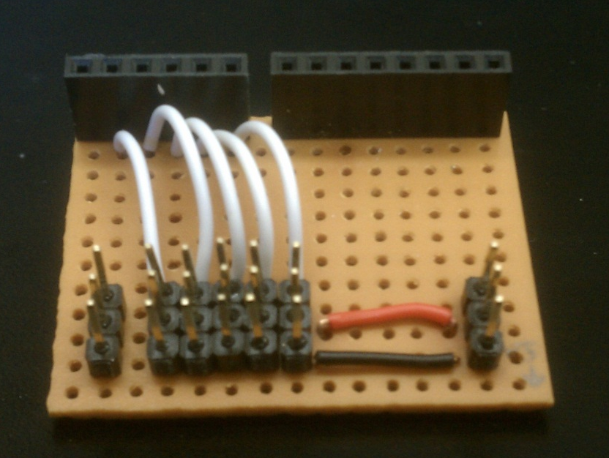
Sensor Power Distribution

Slide 18
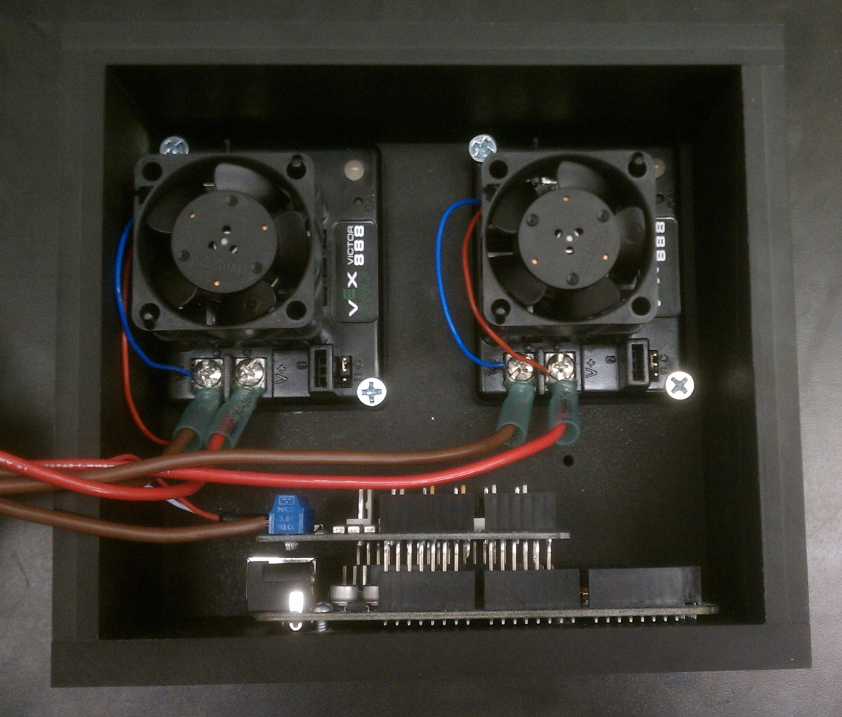
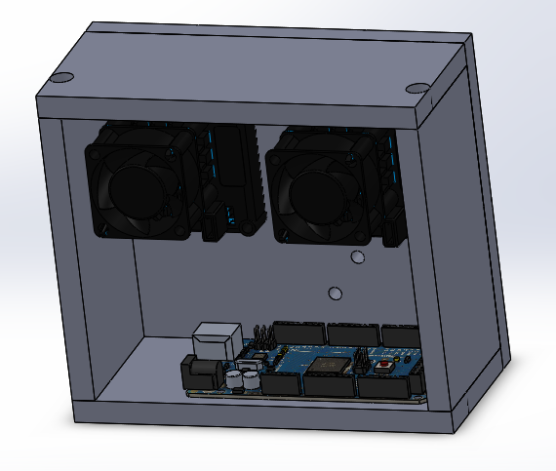
Control Box

Slide 19
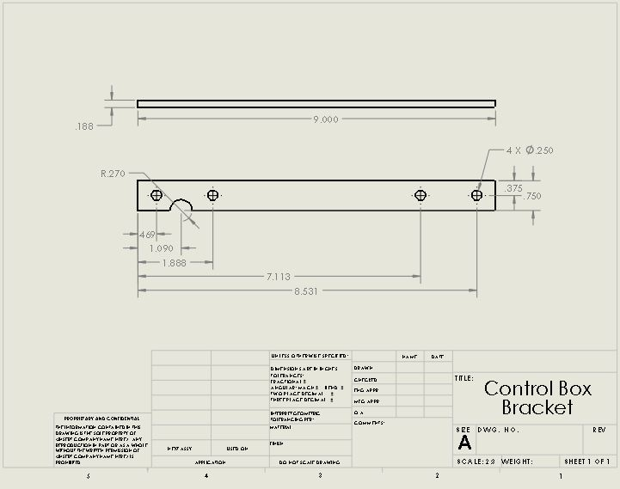
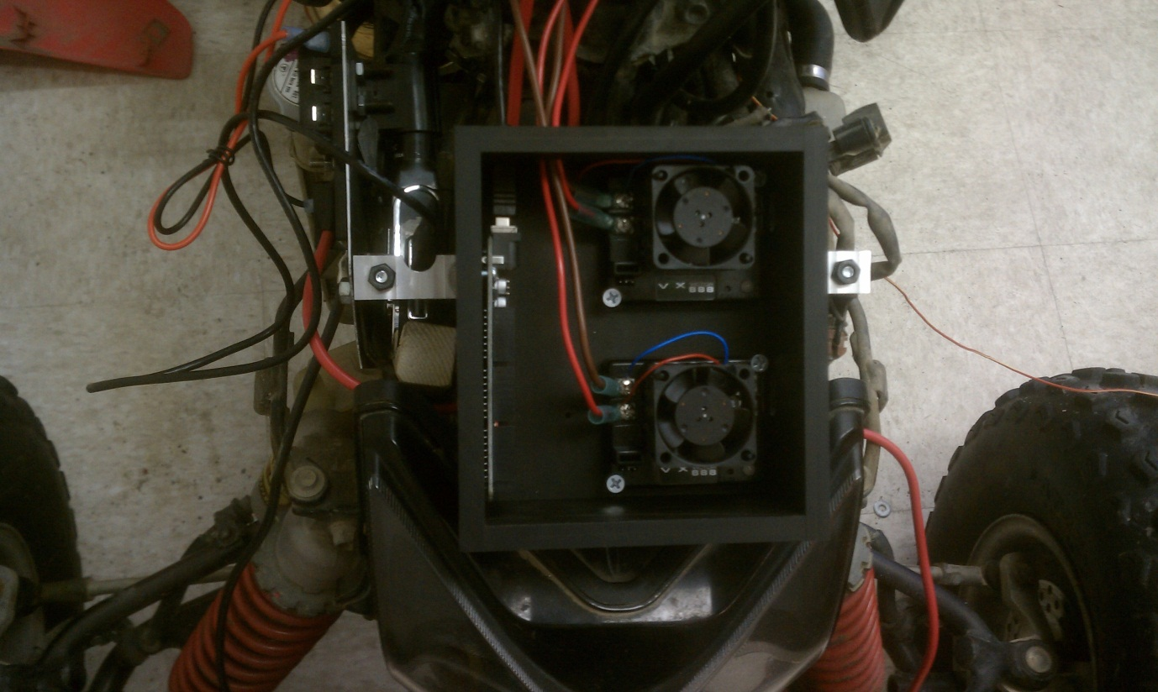
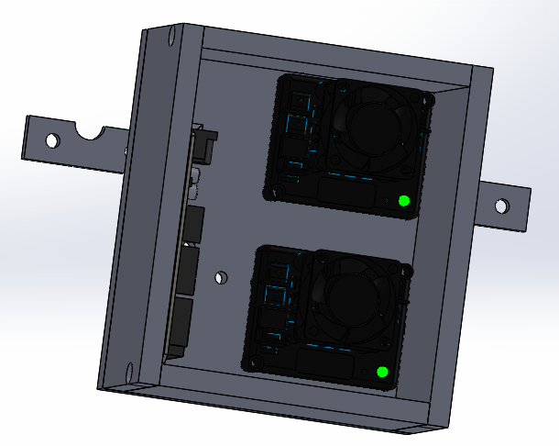
Control Box Mount

Slide 20
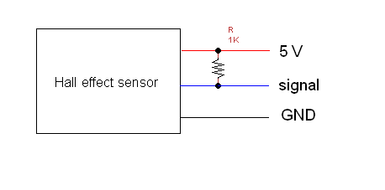
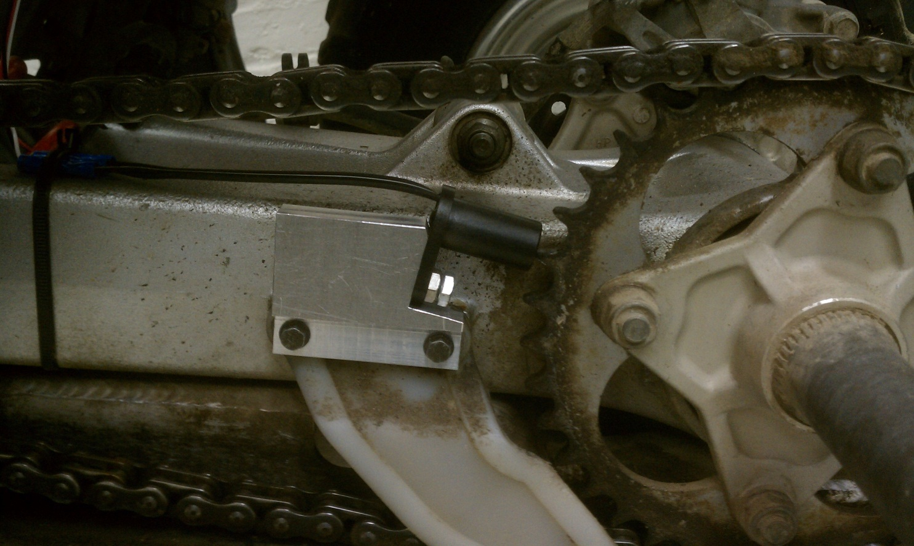
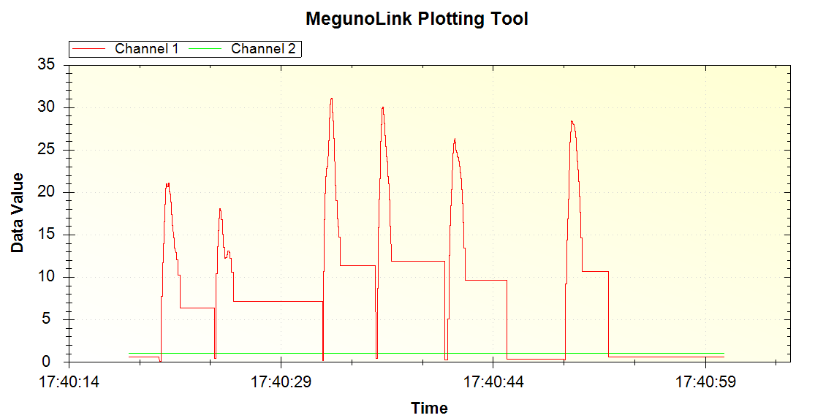
Wheel speed sensor mounted, wired, and tested.

Slide 21
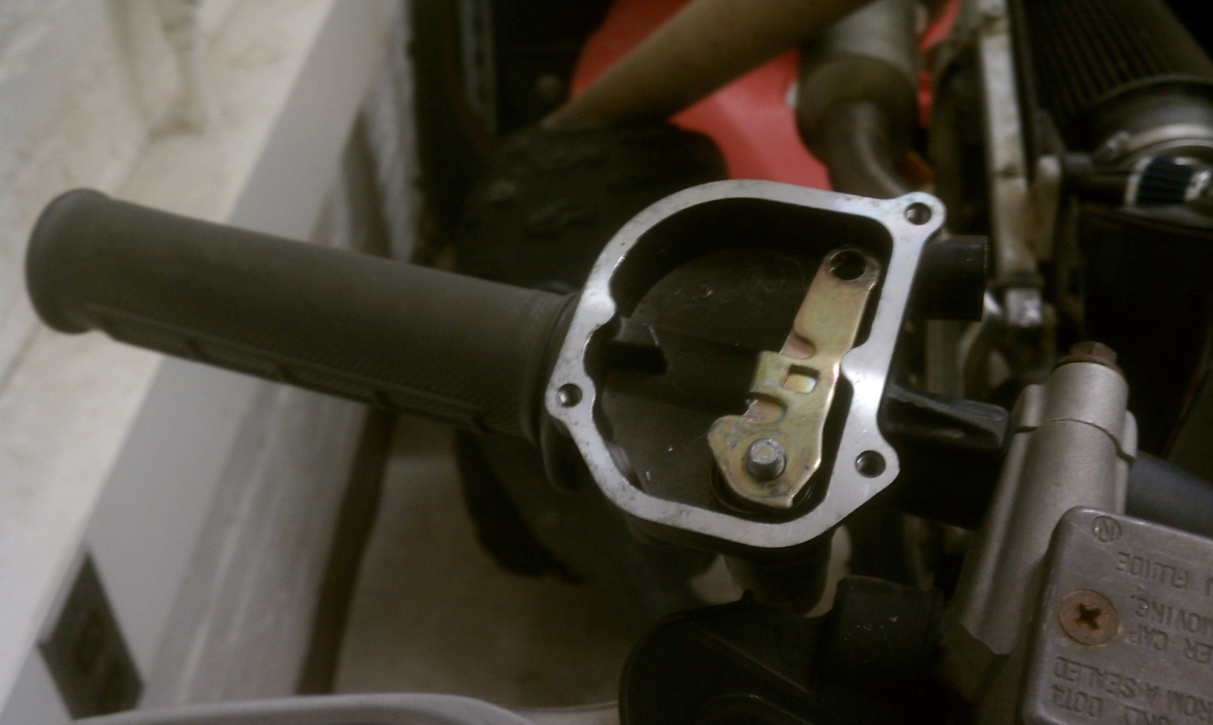
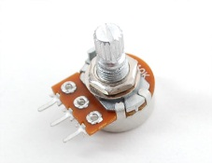
Throttle Position Sensor

Slide 22
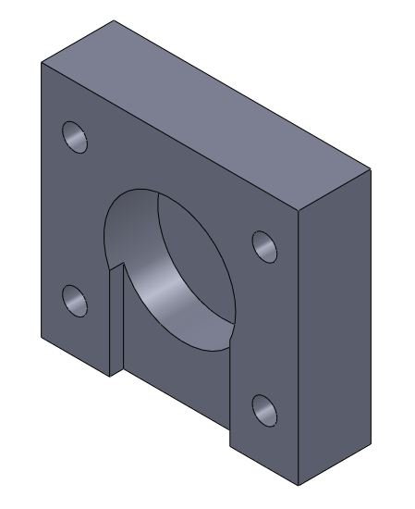
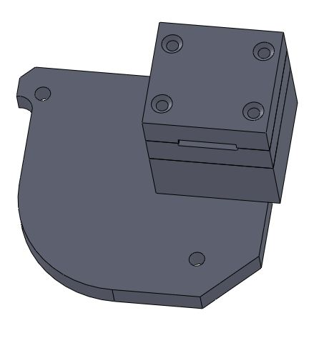
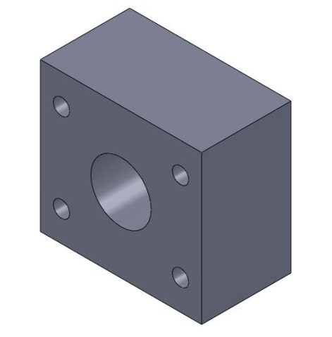
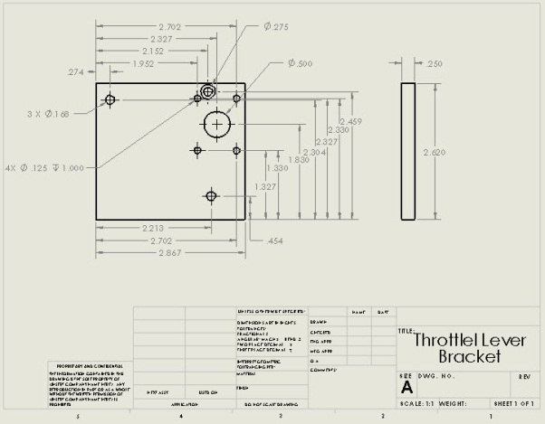
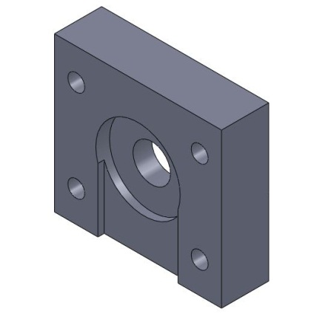



Throttle Position Sensor Design

Slide 23







Throttle Position Sensor Fabrication

Slide 24



Shifter Peg Actuation

Slide 25







Shifter Peg Actuator Mount Design

Slide 26









Shift Peg Actuator Potentiometer Mount

Slide 27







Shift Peg Actuator Fabrication

Slide 28


Shift Peg Actuation Assembly

Slide 29






Throttle Cable Actuator: Previous Presentation

Slide 30







Throttle Cable Actuator Refined Design

Slide 31




Throttle Cable Actuator Finished and Mounted

Slide 32


Everything so far

Slide 33
Questions?

