Slide 1
Smart Transmission
Aaron Grant
Horatio Cowan
Molly Segee
Carl Burnham

Slide 2
Schedule
January: Ordering Parts & beginning fabrication
February: Continuing fabrication & Assembly
March: Assembly and Initial Testing
April: Coding & Calibration
May: Presentation

Slide 3

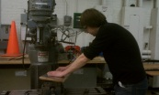
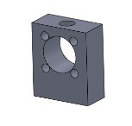

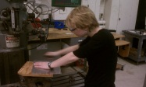

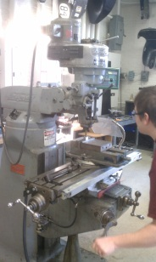
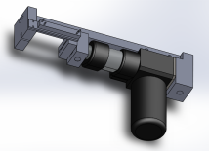
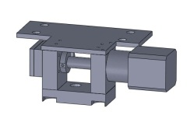
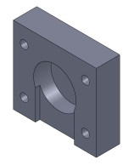
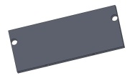
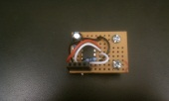
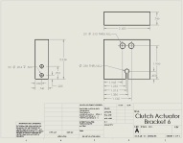
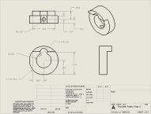
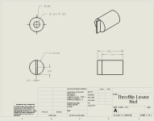
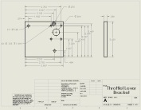
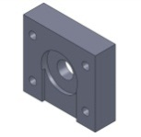
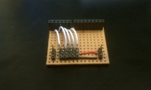
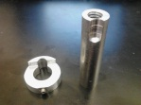
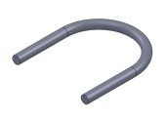
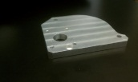
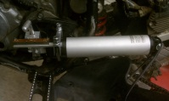
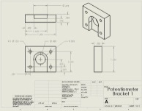
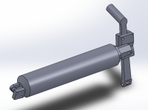
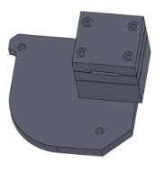
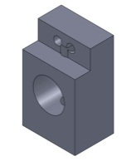
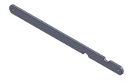
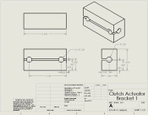
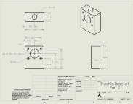
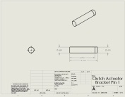

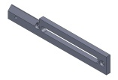
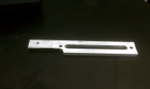
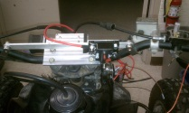
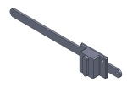
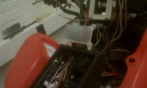
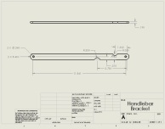
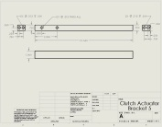
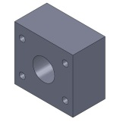

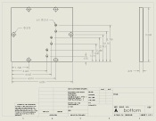
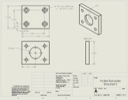
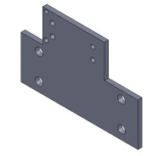
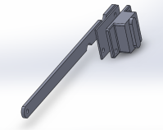
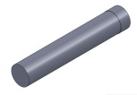
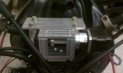
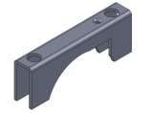

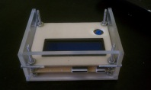
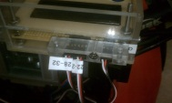
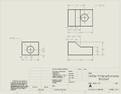
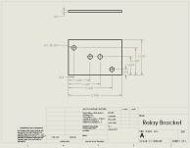
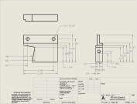
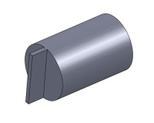
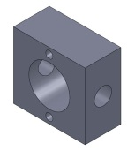

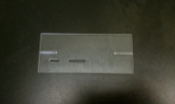



































































Finishing Up Fabrication

Slide 4

Throttle Cable Actuator
Changed the potentiometer attachment method to the same as the one used for the throttle position sensor.
Worried previous attachment method may put too much force on the potentiometer.
This method allows for easy installation and replacement of the potentiometer
Potentiometer attachment wiper

Slide 5








Modified Throttle Bobbin
Larger diameter throttle bobbin to allow for a faster return speed.
Old Throttle Bobbin

Slide 6


Modified Throttle Bobbin Fabricated
Before Modification
After Modification

Slide 7




Throttle Cable Actuator Heat Sink

Slide 8

LCD Screen Wire Harness

Slide 9


Clutch Actuator

Slide 10




Clutch Actuator Strengths and Buckling Check
Yield strength is ~8000 psi. (unsure of the type of the aluminum so there may be some variation)

Slide 11


Clutch Actuator SolidWorks FEA
Minimum factor of safety = 5.32

Slide 12



















Clutch Actuator Mount

Slide 13

Clutch Actuator Fabrication

Slide 14


Clutch Actuator Mounting Location

Slide 15

Mech Lab Experiment

Slide 16

Mech Lab Raw Data
We are picking up some noise on our interrupt pin.
This causes what appear to be extremely high frequencies
We thought that a pull down resistor on the 555 output might fix the problem we are having.
Because that didn’t work, a software filter is used to remove the high frequency noise.
Engine Frequency (Hz)
Time (ms)

Slide 17

Mech Lab Raw Data

Slide 18


Mech Lab data

Slide 19


Mech Lab Data
Linear Curve fit
Exponential Curve Fit

Slide 20

Revised Wiring Diagram
Wiring Diagram has been revised and most pin connections are now correct and permanent.

Slide 21


Continuing Wiring
Most of the wiring is now complete.
A label-maker is used to help keep all the wires in the correct place.

Slide 22

User Feedback & Buttons
For the purposes of debugging and allowing the user to provide some feedback to the system such as asking the bike to go into neutral, buttons have been added.
Buttons & LEDs

Slide 23

LEDs and Buttons

Slide 24


Button wiring
The pull down resistor prevents the Arduino fro picking up noise and thinking it is a button push

Slide 25


Button Code & Debouncing
Denouncing code
Debouncing refers to preventing a single button push from reading as multiple button pushes

Slide 26

State Change Detection
This will allow us to set the shift state to neutral or change what information the LCD is displaying.

Slide 27

Arduino Mega Stopped Working
Arduinos have a communication chip which allows code to be loaded directly from a USB connection.
To communicate directly a boot loader needs to be burned onto the card. If the boot loader is working properly the LED attached to pin 13 will blink when the reset button is pushed.
Pin 13 LED
Reset button

Slide 28





Re-burning the Bootloader
ICSP pins
We need one of these.
AVR ISP
USB tiny ISP
Parallel Port Programmer

Slide 29

Re-burning the Bootloader
We started building a parallel port programmer and were looking for an old computer with a 25 pin parallel port.
Found someone in Barrows who had a couple of different types of programmers.
No Luck!
It appears that the USB communication chip got fried somehow.

Slide 30

New Arduino Powering Method
Because the chip got fried we were worried that the way we were powering it may have been responsible.
We are now powering the Arduino directly off of 12 volts.
Only concern with this method is that the power converter on the Arduino does generate some heat.
12 volt plug

Slide 31
Coding & subroutines
All coding is essentially finished.
More testing needs to be done, however the program has been written.
The coding has largely been done in “subroutines” to break up the code into more manageable chunks. This also allows us to call the same code in multiple places.

Slide 32
Read Values
Block Diagram
Wheel and Engine Speed Calculation
Check Buttons
Decisions!
Stopping
Engine Start
Drive By Wire
Get Going
Go Again
Find Gear
Shift Point Determination
LCD
Shift

Slide 33

Engine and wheel speed noise filtering
Occasionally we get extremely high readings for the wheel or engine speed, probably due to noise on the Arduino pins. These values are ignored by the controller.

Slide 34

Gear detection (findGear)
The controller keeps track of what gear it is in by keeping track of when it shifts. The gear is confirmed by checking the ratio of the engine and wheel speed. If this ratio is not what would be expected for 1 second, the controller updates what gear it thinks it is in. This should catch unsuccessful shifts.

Slide 35

Gear confirmation (confirmGear)
This subroutine compares the gear that the code thinks it is in due to having moved the shift peg, withthe gear it thinks it is in due to the ratio of the wheel speed to the engine speed.
If the two do not match, and do not match for more than a second, then the code assumes that the gear ratio is the correct gear.

Slide 36


Gear shifting decision making (shiftPointDetermination)
This is based on our mech lab data. We measure the throttle position and determine at which wheel speeds the vehicle should shift for that throttle position. We then compare these against the current wheel speed to determine if a shift is needed.

Slide 37

Drive by Wire Code (drivebywire)
Reads the throttle position
Maps those values to the appropriate range for the cable actuator.
If the two values differ more than a predefined tolerance then the stepper motor moves forward or backward one step at a time until they are within the tolerance.
A slower speed is set for when reeling the cable in. (slower steps are more powerful)

Slide 38



Shift Peg Actuator Code (moveshifter)
Trying it without a PID control first
There shouldn’t be enough inertia in the system for overshoot and oscillations to be an issue.
First checks if it needs to shift up, shift down, shift to neutral, or go to the middle position.
Using a pre-defined potentiometer value, it calculates the difference
Between where it is and where it needs to be.
It then moves to that position, and then sets the state back to the middle position.

Slide 39

Testing moveshifter()

Slide 40


Clutch Actuation (clutchActuate)
If moving the clutch would go beyond the limit of how far the clutch can go, the clutch actuator is stopped and the clutch state is set back to 0 (the ‘do nothing’ state).
This subroutine will either disengage the clutch quickly, engage the clutch quickly, engage the clutch slowly, or engage the clutch very slowly, depending on the number given to it in clutch state.

Slide 41

Preparing to start the engine (enginestarting)
This code shifts down until it senses that it is unable to push the shift peg down (due to being in first gear)
The code then shifts to neutral and is sets a variable which tells the code that the engine is ready to be kick started.

Slide 42

Shifting code Testing

Slide 43


Starting from a stop (getgoing)
If the engine is running, the wheel speed is below a certain threshold, and the throttle is above a certain low threshold, the function ‘getgoing’ is called.
This function controls the engine speed with a PID controller to keep the engine from stalling. It also lets out the clutch very slowly.
If the wheel speed goes above a certain threshold, the user is given back control of the throttle
If the user lets off the throttle, the clutch is pulled back in.

Slide 44

Engaging the clutch while moving (goingagain)
If the clutch is not fully engaged, the throttle is above a certain threshold, and the wheel speed is above a certain threshold, this function ‘goingagain’ is called.
This lets the clutch out slowly and lets the user continue to control the throttle. If the throttle is brought to zero before the clutch has fully let out, it will be brought back in.

Slide 45

Stopping (stopping)
If the wheel speed drops below a certain level while the clutch is engaged and the throttle is at zero, this function will disengage the clutch.

Slide 46


Engine speed control (RPMdrivebywire)

Slide 47
Engine speed control PID
Min throttle position
Analogous to % throttle
subtract
error
Throttle match
Engine RPM
Desired Engine RPM
PID
add
Engine
Varies from 0 to 524
Desired throttle position

Slide 48


Adaptive tuning with a PID control
Using this method allows for a quick response time while avoiding excessive oscillations when we are close to the setpoint.
Higher RPM
Border
Setpoint
Border
Lower RPM

Slide 49

Testing with computer control of clutch and throttle

Slide 50
Coding error during testing
We missed a curly bracket in our clutch actuation subroutine.
This caused the clutch actuator to continue to pull on the clutch cable after it was all the way in.

Slide 51

VS

Slide 52

The Linear Actuator Won

Slide 53


Clutch limit switch
To prevent this from happening again, we added a limit switch to the clutch actuator which will brake the clutch actuator if it is pressed.
The limit switch is on an interrupt pin so that the clutch actuator will stop no matter where you are in the code.

Slide 54



Website Updated

Slide 55
Questions?

